Slide 1
Canadian Independence

Slide 3
Ontario
Quebec
Nova Scotia
New Brunswick
Manitoba
British Columbia
Prince Edward Island
Saskatchewan
Alberta
Newfoundland and Labrador
Nunavut
Northwest Territories
Yukon Territory
Ottawa
Toronto
Calgary
Winnipeg
Quebec City
Vancouver
Montreal
Edmonton

Slide 4
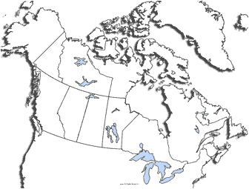

Slide 5
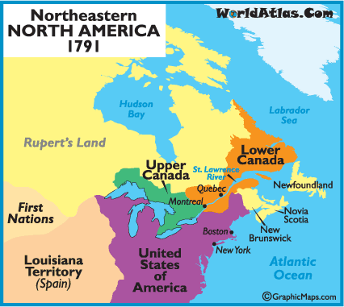

Slide 6
Canadian Independence
Evolutionary not Revolutionary
1759 – British defeat France to secure Quebec
Ends Seven Years War
1776-1783 American War for Independence
British defeated and reconsolidated NA holdings
1791 – Constitution Act of 1791
Parliamentary system
Lower Assembly had power to tax (but not spend)
1837 – Armed Rebellion in Upper and Lower Canada

Slide 7
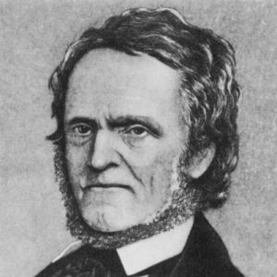
Upper Canada
William Lyon MacKenzie
Sought republican ideas
US born citizens should vote, Responsible Gov’t, power to elected assembly, end of power of Anglican Church
Turned to armed rebellion
British defeated him
How to best keep colony British (not whether)

Slide 8
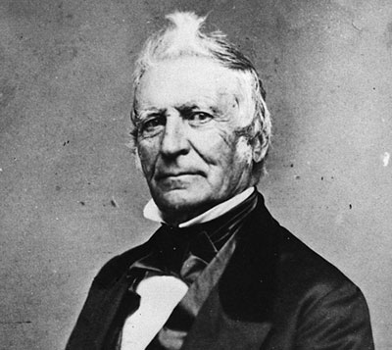
Lower Canada
Louis Joseph Papineau
Advocate of republic
Responsible gov’t
French and British could not get along
1837 – Assembly gave governor control of purse
Armed violence
British put down

Slide 9
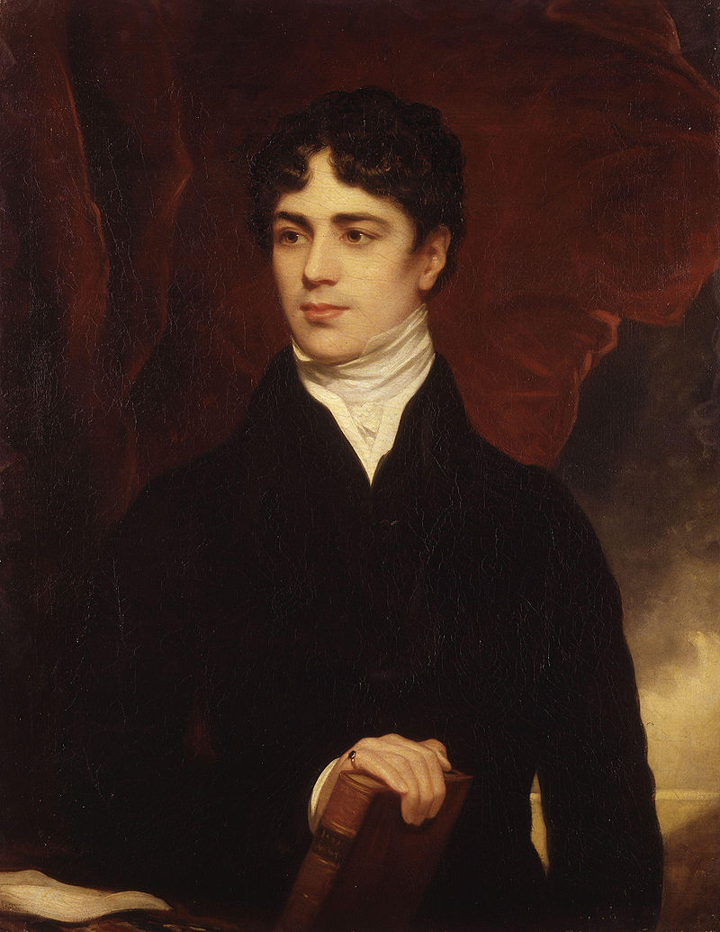
Durham Report
Lord Durham assigned to fix problems
United the Colonies
Granted responsible government
Eventually (1867) Canada would become an independent dominion within British Empire

Slide 10
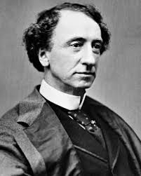
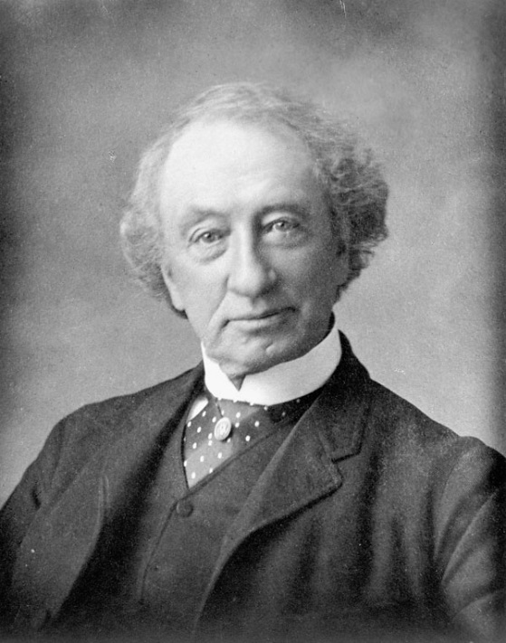
Charlottetown Conference
Sept 1864
British-led
Wanted to unite Nova Scotia, Prince Edward Island, and New Brunswick
John MacDonald
No union among the three
Talks of a greater Union

Slide 11
Quebec Conference
October 1864
Goal to develop plans for confederation
72 Resolutions
Bicameral Legislature
Commons
Senate
French Speaking Quebec preserved

Slide 12
A lot of resistance to Confederation
Fenian’s raids, Purchase of Alaska , etc raised concern

Slide 13
London Conference
December 1866 – February 1867
British North America Act
72 Resolutions was basis
Federal system of government
Parliamentary
A lot of power to provinces (each with a single house legislature)
Two official languages
Ottawa capital
MacDonald 1st Prime Minister
Would build transcontinental railroad
Canada fully independent 70 years later

Slide 14
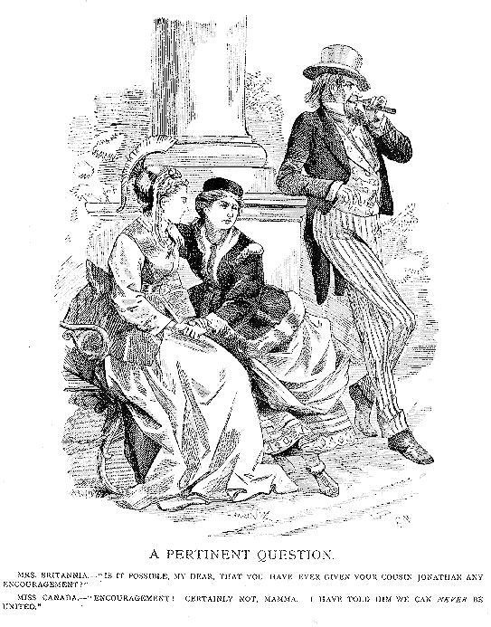

Slide 15
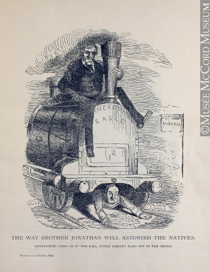

Slide 16
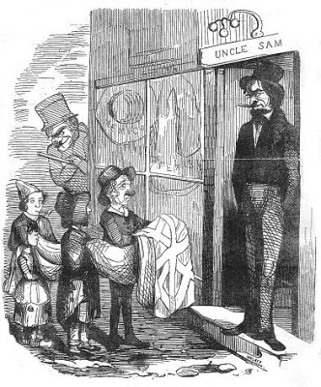
Little Ben Holmes: “And some naughty children attempt to pawn their mother’s pocket-handkerchief but are arrested by policeman who was stationed around the corner

