Slide 1
The Classical Period
(The Peak)
500 – 338 BCE

Slide 2
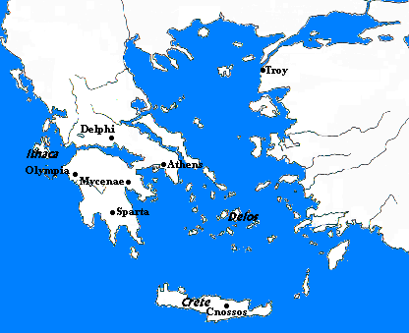
Warfare
Ionian Greeks rebelled
Athenian help
Persians struck at Athens
Defeated at Marathon

Slide 3
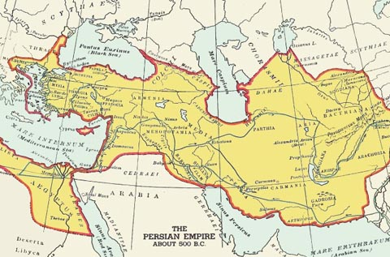

Slide 4
Persian War
Persians struck again by land
Stalled at Thermopylae
Defeated at Salamis

Slide 5
Results of Persian War
Athens viewed as leaders (navy)
Delian League formed (478 BCE)
Athens formed naval alliance to liberate Ionia from Persian rule
Turned into Athenian Empire
Alarmed others
431 BCE – Athenian imperialism drove Sparta to conflict

Slide 6
Peloponnesian War
431 – 404 BCE
Sparta vs. Athens
Costly and devastating
Plague rips through besieged Athens
Pericles killed

Slide 7
Peloponnesian War
Sparta wins
Athens power destroyed
Sparta exerts control on rest of Greece and fails
Persian help
Thebes also tries

Slide 8
Classical Period
The Arts
Acropolis
Temples
Display obsession with human form
Captured reason and dignity of humans

Slide 9
Theater
Sophocles
Antigone
Oedipus Rex
Euripedes
Explored personal conflict and individual
Tragedy is flaws that let passion overcome reason
Aristophones
Humor as political commentary

Slide 10
Philosophy
Created to understand universe in physical terms
Pre-Socratic
Universe is subject to natural laws
General concepts
Atomic theory

Slide 11
Hippocrates
Medicine
Explain and treat diseases
Empirical knowledge, not magic

Slide 12
Socrates
Pose questions and seek answers
Killed in 399 BCE
Plato
Academy
Aristotle
Observation and analysis

