Slide 2
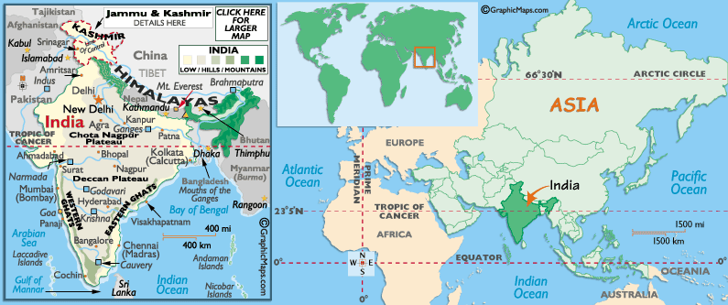

Slide 3
Notes:
The ITC is an area of warm moist air.

Slide 6
Mauryan Empire
323 BCE – 185 BCE
Chandragupta Maurya – founder
1st Unification of the Subcontinent
Secular ruler
Renounces it all to become a monk, starves to death
NE India along the Ganges river
320s BCE – rapid expansion due to the power vacuum left by Alexander
Centralized w/ strong bureaucracy
Influenced by the Persian bureaucracy

Slide 7
Mauryan Economy
Largely Agriculture
Iron plow invented while Aryans ruled
Sharecropping; Landless Peasants
High Rent
Weather
Famine
Wheat, barley, millet, (some rice)
Vegetables, cotton, spice (pepper, ginger, cinnamon, saffron)

Slide 8
Economy
Trade
Rim of Pacific, Middle East, Mediterranean Sea
Traded spices, wood, perfumes, jewels, textiles, precious stones, ivory, wild animals
Traded for gold, tin, lead, wine
Money economy developed around 200 BCE when metals were introduced

Slide 9
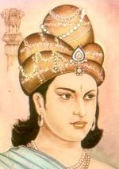
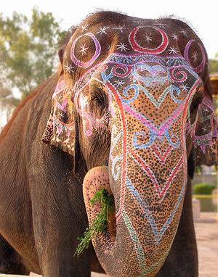
Ashoka the Cruel becomes…
Grandson of CM
Reigns 268-232 BCE the high point of the Mauryans
Pataliputra – capital city
Central treasury for taxation
Excelled at war
9000 elephant army

Slide 10
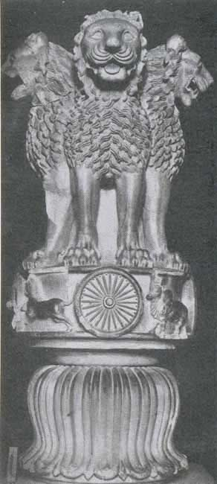
…Ashoka the Just
Destroys his rivals, but has regrets
promotes Buddhism & nonviolence
Pillar edicts – promote his new views
Human rights
Religious tolerance
Animal rights/conservation
Irrigation and roads
Empire begins falling apart upon his death
The lion capital of Ashoka is an official symbol of the modern Republic of India. The Wheel of Law or the "Ashoka Chakra" is featured on the current Indian flag.

Slide 11
Downfall
After Ashoka died in 232 BCE: decline
183 BCE: last Mauryan ruler overthrown by military
Disunity
Several kingdoms vied for power
Why?
“Rule of the Fishes”
Unity will not come again for 500 years

Slide 12
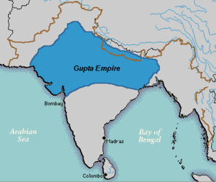
Guptas
320 CE – around 550 CE
Founded by Chandra Gupta
Forged alliances with powerful families
Conquered land
Tributary alliances
More autonomy in regions than Mauryans

Slide 13
Religion
Hindu, but tolerant

Slide 14
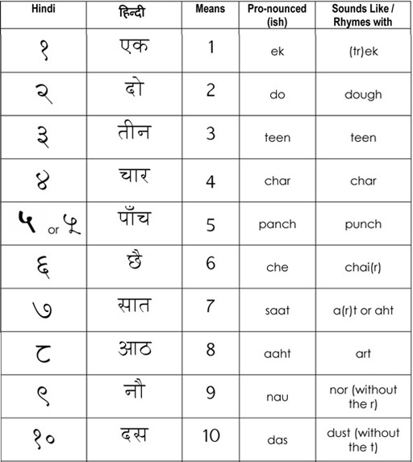
Advancements of Guptas
Science: Plastic surgery, spherical earth
Mathematics: symbol for zero, flexible numerals, pi

Slide 15
Decline of Guptas
Huns invaded during fifth century CE
Guptas successful at first
Defense was expensive, weakened state
Eventually, Gupta Empire broke apart
Local rule

Slide 16
Buddhism Split
Theravada
Closest to teachings of Buddha
Strict adherence to personal behavior
Not a salvationist creed
Mahayana
Nirvana could be achieved through devotion
Buddhism as religion over philosophy
Buddhism declined in India
Rejection of caste system
Hinduism became less elitist (more/better ways to achieve karma

