Slide 2
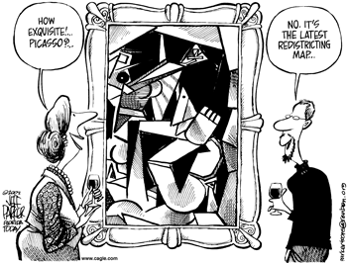
Gerrymandering – drawing district lines to the advantage of a political party that controls the state’s legislature

Slide 3
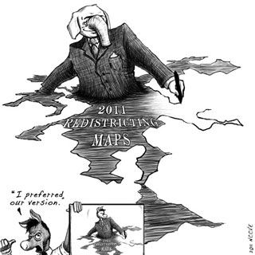

Slide 4
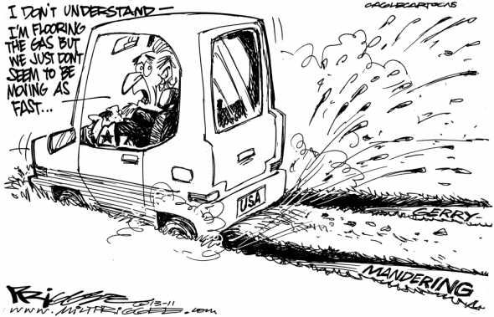

Slide 5
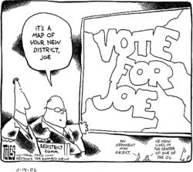

Slide 6
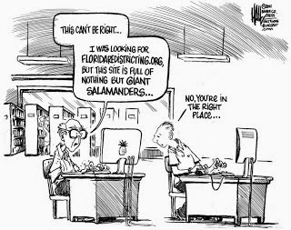

Slide 7
Wesbury v. Sanders -1964
Districting had favored rural populations
Ended rural overrepresentation by making the populations of districts equal
“one person, one vote”
Race can’t determine a district, but it can be a factor

Slide 8
House of Representatives
Qualifications for office
25 years old
Have been a citizen for seven years
Be an inhabitant of the state from which he or she is elected
(customarily, the representative must live in their district)
House is the judge of qualifications
People were rejected on account of politics
As of 1969, you can only be rejected for the above qualifications
House can expel you for misbehavior
Informal qualifications exist depending on the district

Slide 9
The Senate
Qualifications for office
30 yrs old
Be a citizen for at least nine years
Live in the state from which you are elected
Informal qualifications exist
Senate can judge qualifications of senator
Senate can expel you by 2/3 majority

Slide 10
The Senate
2 senators per state
Elected by a majority in the state (since 17th amendment in 1913)
6 year term
Each senator’s term is staggered (33 or 34 elected every two years)
Continuous body– all seats are never up for election at the same time
No limit of terms

Slide 11
Congress
Four ways to vote/represent the people:
Delegate – vote according to the people that elected them
Trustee – judge each question on its merits
Partisan – one owes their first allegiance to their political party and vote on party lines
Politico – combine each of the four

Slide 12
Congress
Committee members – screen proposals as bills and decide which will go to floor consideration
Oversight function– congress (using comittees) checks to see that the executive branch agencies are carrying out the policies that congress set by law

Slide 13
Powers of Congress
Expressed Powers
Commerce power—regulate interstate and foreign trade
Gibbons v. Ogden – ruled that the federal government had power in interstate trade (here in relation to steamboats)
Civil Rights Act of 1964

Slide 14
Expressed Powers
Power to tax

Slide 15
Implied
inherent

