Slide 1
Dark Ages/Early Middle Ages

Slide 2
After Rome
East – Byzantine Empire
Involved in trade, religious disputes, and Crusades
Buffer Zone
Will become more Eastern
West –
Far removed from Roman greatness (leftovers)
Germanic Kingdoms
Only one entity controlled loyalty of all Europe

Slide 3
“Dark Ages”
Church power influence grew
Local kings and leaders vied for power
No rights for commoners

Slide 4
Franks
Clovis
Christianity
Kingdom split up upon death
Muslims took Spain
Stopped at Battle of Tours (732)
Charles Martel

Slide 5
Carolingians
Charles the Great (Charlemagne)
Leo III
Crowned Charlemagne Roman Emperor
Treaty of Verdun
Split empire into three

Slide 6
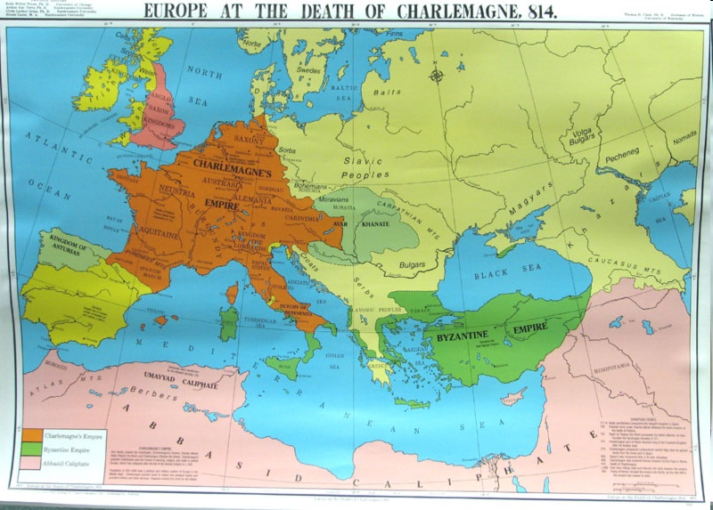

Slide 7
Church Power Grew
Life revolved around religion
Major holidays were all religious
Sacraments necessary for heaven
All religious texts in Latin

Slide 8
Emergence of Feudalism
Invaders
Fear
Hunger

Slide 9
Feudalism
Vassals are protected by lords whom they had to serve in war
Land is the only source of wealth
Vassals exercised rights of jurisdiction and political authority

Slide 10
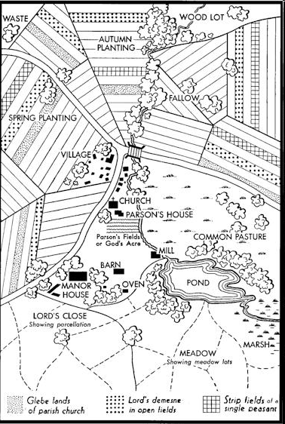
Manor system
Estate (manor) worked by dependent peasant class
Serfs – bound to land (60% of peasants)
Labor service, rents, under jurisdiction of lord

Slide 11
Why Feudalism/Manorialism?
Early Middle Ages followed trends started in decline of Rome
Viking and Magyar invasions

Slide 12
Revival
Around 1000 CE: Revival
Agriculture Boom (An agricultural revolution)
Three field System
More food → population boom

Slide 13
Revival
Viking attacks die down
Bigger cities
Trade revival (along with introduction of luxury goods)
Rise in merchant class
Especially in northern Italy

Slide 14
The Byzantine Empire
Justinian
Expansion
Nika Rebellion
Building Projects (Hagia Sophia)
Codification of Roman Law

