Slide 2
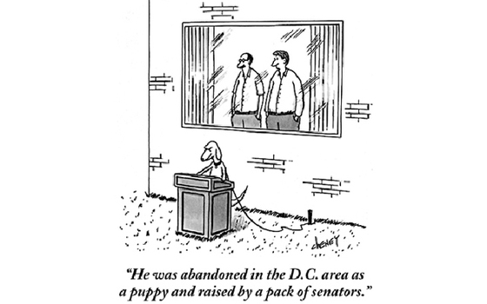
Congress
Filibuster

Slide 3
Executive Branch
Presidential Roles
Chief of state
Chief executive
Chief administrator
Chief diplomat
Commander in chief
Chief legislator
Chief of party
Chief citizen

Slide 4
Qualifications for Presidency
Be a natural-born citizen
35 yrs old
Be a resident for 14 years
Presidential Term: 4 years
Limit: Two terms (22nd Amendment)

Slide 5
Presidential Succession
Order set in Presidential Succession Act of 1947
1.) Vice-President
2.) Speaker of the House
3.) President pro tempore of the Senate
Most senior senator in the majority party
4.) Secretary of State
5.) Secretary of Treasury
6.) Secretary of Defense
Order of formation of office

Slide 6
1.) Vice-President
2.) Speaker of the House
3.) President pro tempore of the Senate
4.) Secretary of State
5.) Secretary of Treasury
6.) Secretary of Defense
7.) Attorney General
8.) Secretary of the Interior
9.) Secretary of Agriculture
10.) Secretary of Commerce
11.) Secretary of Labor
12.) Secretary of Health and Human Services
13.) Secretary of Housing and Urban Development
14.) Secretary of Transportation
15.) Secretary of Energy
16.) Secretary of Education
17.) Secretary of Veterans Affairs
18.) Secretary of Homeland Security

Slide 7
Presidential Disability
(25th Amendment) Vice-President can become acting president if the pres is incapacitate
President can do so in writing
Vice-President and majority of cabinet can do so in writing

Slide 8
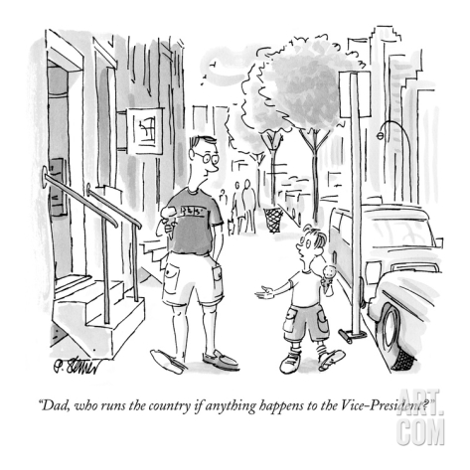
Executive Branch
Vice-Presidency
Constitution:
Preside over the Senate
Decide presidential disability
Practice
“Balance the ticket”
Vacancy
(25th Amendment) President will nominate another VP and Congress will approve

Slide 9
Elections
Primaries
Convention
General Election

Slide 10
Executive
Electing the President
Campaigning – stump speeches, debates, commercials, internet, etc.
Convince swing voters – 1/3 of electorate who has not made up their mind
Battleground states – states in which either candidate could win
Election
Electoral College
Electors chosen by popular vote in every state
Except Maine and Nebraska
Winners must win a majority (270 out of 538)
Tues after the first Mon of Nov. every four years

Slide 11
Flaws in Electoral College
Winner is not guaranteed the presidency
(Has happened four times)
Smaller states have a larger proportion of electorates
Electors are not required to vote for the candidate who won majority in state
Has only happened in primaries
House can decide if no majority

Slide 12
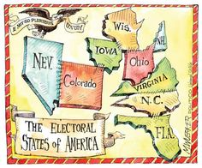

Slide 13
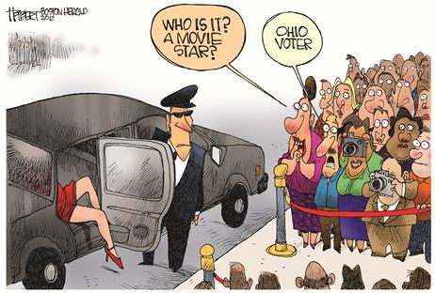

Slide 14
Proposed Reforms for Electoral College
District/Proportional Plans (share of electoral votes based on election results)
Direct Popular Election
Would require a constitutional amendment
National popular vote
Electors will cast votes to whomever wins the popular election
Needs state legislators and an interstate agreement

Slide 15
In Defense of the Electoral College
Issues are rare
It is a known process
Results are quick and accurate
Promotes the two party system (3rd party obstacle is enormous)

Slide 16
Expansion of Executive Powers

Slide 17
Executive Powers
Ordinance Power
Executive orders– directives, rules, or regulations
Appointment Power
Includes cabinet members, ambassadors, federal judges
All need Senate confirmation (simple majority)
Diplomatic Powers
Power to make treaties
Needs Senate confirmation (2/3 majority)
Pres can make executive agreements with head of foreign state (no need for approval)
Ex.: Destroyers to Great Britain before WWII
Power of Recognition
Can recognize an entity as a state

Slide 18
Executive Powers
Commander in Chief
Can instruct generals, etc.
Making undeclared war
Congressional Resolution
Congress can enact joint resolution to authorize the president to use military force
Other military powers
Can aid another gov’t against a coup
Can oust other gov’ts
War Powers Resolution of 1973
President can commit military forces to combat only
If Congress has declared war
If Congress has authorized an action
When an attack on the nation or its armed forces has occurred
Any commitment must end within 60 days (unless Congress extends it)

Slide 19
Executive Powers
Legislative powers
Can recommend legislation
Veto power
Can sign or veto
Congress can override (2/3 in both chambers)
Pocket veto only at end of congressional session
Line-Item Veto
Can veto certain things such as dollar amounts
Can call special sessions

Slide 20
Executive Powers
Judicial Powers
Power of clemency (mercy)
Reprieve – postponement of the execution of a sentence
Pardon – legal forgiveness of a crime
Commutation – power to reduce a fine or sentence
Amnesty – blanket pardon to a group of people

Slide 21
Federal Bureaucracy
Bureaucracy – large complex administrative structure that handles the everyday business of an organization
Hierarchical Authority
Job Specialization
Formalized Rules

Slide 22
Executive Office of the Presidency
All employees legally subordinate to president
Help execute duties of government
Deal with budget, advising,
Cabinet
Independent Agencies

Slide 23
Financing the Government

Slide 24
