Slide 1
French Revolution

Slide 2
People
King Louis XVI/Marie Antoinette
Maximilien Robespierre
Napoleon

Slide 3
1787/1788 – Famine
1789
Estates General Met
National Assembly
Bastille
Declaration of the Rights of Man
August Decrees
1791
Constitution

Slide 4
The king
Louis XVI attempts to escape, but fails
Rest of Europe scared that revolution will spread

Slide 5
Sans-culottes (working class) turn revolution more radical
Demand republic
Found support in the Jacobins
Political club made up of middle class
Gain upper hand, fought rest of Europe

Slide 6
Radical Revolution
Reelected legislative body (National Convention)
All men could vote
Established republic
Monarch abolished August 1792
Louis executed

Slide 7
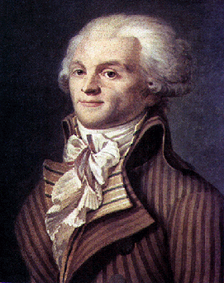
The Republic
Department (Committee) of Public Safety
Had to defend France
Battled counterrevolutionaries
Robespierre
Reign of Terror
Guillotine

Slide 8
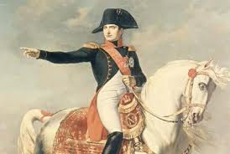
Eventually Robespierre is killed
Third stage: moderate – The Directory
Middle class in charge
Peace with Europe
Too weak/Corrupt
Napoleon

Slide 10
“Rebellion against a king may be pardoned, or lightly punished, but the man who dares to rebel against the laws of a republic ought to suffer death.” -- Samuel Adams
“A little rebellion now and then is a good thing. It is a medicine necessary for the sound health of government. God forbid that we should ever be twenty years without such a rebellion.” – Thomas Jefferson

Slide 11
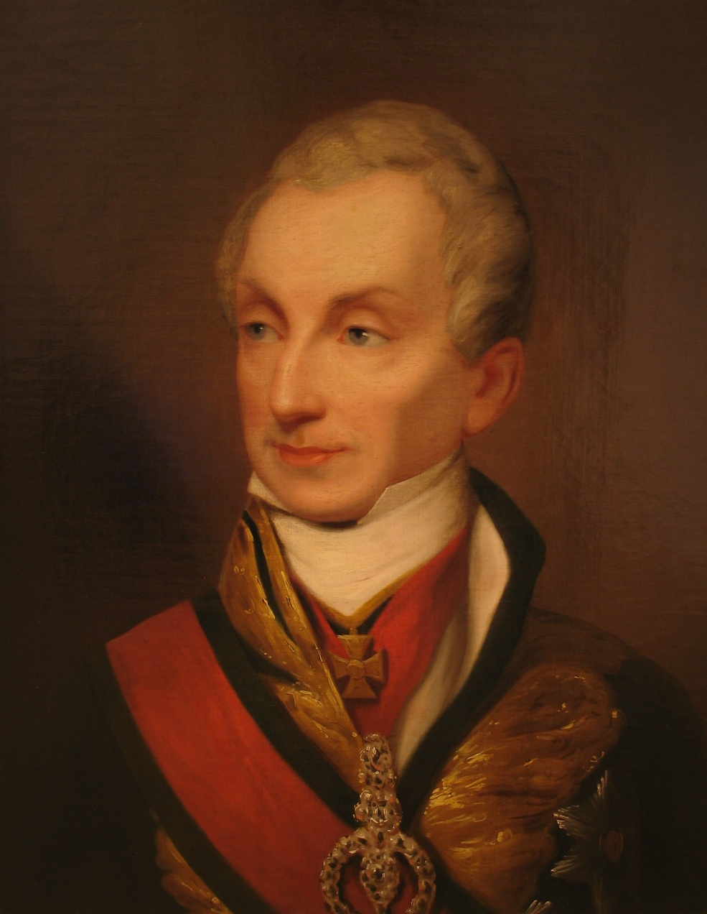
Congress of Vienna
What do you do with France? With the Revolution? With Napoleon?
Klemens von Metternich
Principle of Legitimacy
Restore legitimate monarchs—preserve traditional institutions

Slide 12
Congress of Vienna
Conservative Backlash
Favored obedience to political authority, organized religion
Hated revolutionary upheavals, liberal demands for civil liberties, and representative governments

Slide 13
Congress of Vienna
Formed Concert of Europe
Great Britain, Russia, Prussia, and Austria (later France) met to maintain the peace of Europe
Principle of Intervention
If there is a revolution, the rest of Europe can restore legitimate monarchs to their throne

Slide 14
Congress of Vienna
Nationalism
Arose out of an awareness of being part of a community that has common institutions, traditions, language, and customs
Community is a nation – individual’s primary loyalty is toward that community
Not liked by conservatives

Slide 15
Congress of Vienna
Balance of Powers
To prevent wars, all countries have equal power

