Slide 1
Election Process

Slide 2
Nomination
Parties nominate a candidate
Put on ballot by:
Self announcement
Caucus (a group meets to select the candidates to support—usually at local level)
Convention (delegates pick)
Direct primary (intra party election)
Closed Primary
You can only vote in your declared party
Open Primary
You pick which party to vote in
Some public, some private
Petition

Slide 3
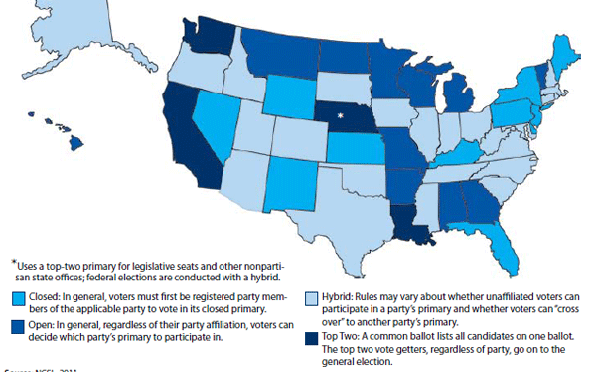

Slide 4
Elections
Ballot – medium by which one registers choice
Absentee voting – vote by mail
Coattail effect – a strong candidate at the top (for president) attracts voters to vote for the same party on the rest of the ballot
Ex. Reagan 1984 and Obama 2008
Reverse: McGovern 1972 and Goldwater 1964
Precinct – voting district
Polling place – place where you actually vote

Slide 5
Money and Elections
Campaign spending
Sources of Funding
Small contributors
Wealthy individuals
Candidates
Political Action Committees (PACs) –political arms of special-interest groups with a stake in electoral politics
Super-PACs can not directly contribute in an election

Slide 6
Money and Elections
Regulation
Federal Election Commission (FEC)
Requires disclosure, limits on contributions to campaigns and PACs, etc.
Hard money –given directly to campaigns
Soft money – given to other accounts

Slide 7
Interest Groups
Business groups
Trade associations
Labor unions
Agriculture Groups
American Farm Bureau Federation, National Farmers Union, etc.
Professional Associations
American Medical Association, National Education Association
Issue-Oriented Groups
Right-to-Life, NRA, National Wildlife Federation, Planned Parenthood,
Organizations for Specific Groups
AARP, NAACP
Religious Organizations

Slide 8
Interest Groups
Influencing the Gov’t
Direct Approach
Lobbying – the process by which organized interests attempt to affect the decisions and actions of public officials
Court cases taken to Supreme Court
Indirect
Grass-routes – from the people at large
Shape public opinion
propaganda

Slide 9
Congress
Bicameral
Senate (2 per state)
House (based on pop of state)
Congressional Term: 2 years
Session: In a year, when the congress meets
Recess: when congress temporarily suspends business
Special session: a meeting to deal with some emergency situation

Slide 10
Congress
House of Representatives
Number of seats based on Census
435 seats (permanent number since Reapportionment Act of 1929)
1 rep for every ~700,000 citizens. Each represents a district
Elected on the Tuesday after the first Monday of November every two years

Slide 11
Political Parties

