Slide 1
The Constitution

Slide 2
Dates
1781 Yorktown, Articles of Confederation
1783 Treaty of Paris
1787 Constitutional Convention – Philadelphia
Adopted Sept. 17, 1787
Effective June 21, 1788
First Congress March 4, 1789
First President April 6, 1789
Ratification May 29, 1790
Bill of Rights December 15, 1791
Notable People
James Madison
Benjamin Franklin
George Washington
George Mason
Alexander Hamilton
John Jay

Slide 3
Basic Principles
7 Articles
I. Legislative
II. Executive
III. Judicial
IV. Relations among the states
V. Amending the Constitution
VI. National debts, supremacy of national law, and oaths of office
VII. Ratifying the Constitution
27 Amendments

Slide 4
Basic Principles
Popular Sovereignty – the people are the source of any and all governmental power, and gov’t can exist only with the consent of the governed.
Limited government – gov’t is restricted in what it may do, and each individual has rights that gov’t can not take away
Constitutionalism – idea that gov’t and those who govern must obey the law
Separation of powers – the executive, legislative, and judicial powers are divided among three independent and coequal branches of gov’t

Slide 5
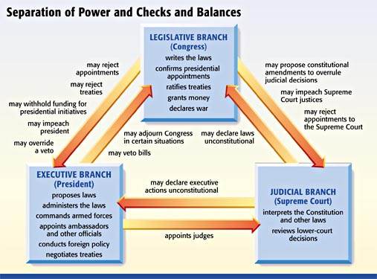
Basic Principles
Checks and Balances – system of overlapping the powers of legislative, executive, and judicial branches to permit each to check the actions of others

Slide 6
Basic Principles
Judicial Review – the power of a court to determine the constitutionality of a governmental action
Federalism – a system that divides power between a central, or national, government and several regional governments

Slide 7
Change
Formal Amendment
Method 1:
1. Proposal by 2/3 of both houses of congress
2. Ratification by ¾ of state legislatures
OR: Ratified by conventions in ¾ of the states
Method 2:
1.Propesed at a national convention called by congress and requested by 2/3 of the states legislatures
2. Ratified by ¾ of state legislatures
OR: Ratified by conventions in ¾ of the states

Slide 8
Change
Other Means
Legislation
Executive Action
Court Decisions
Party Practices
Custom and Usage

Slide 9
Chapter 2: Federalism
In a dispute between the states and the national government, which prevails?
Article VI:
“This Constitution, and the laws of the United States which shall be made in Pursuance thereof; and all Treaties made, or which shall be made, under the Authority of the United States, shall be the supreme Law of the Land; and the Judges in every State shall be bound thereby, any Thing in the Constitution or Laws of any State to the Contrary notwithstanding.”
Constitution, national laws, and treaties

Slide 10
In a dispute between the states and the national government, which prevails?
Amendment X
“The powers not delegated to the United States by the Constitution, nor prohibited by it to the States, are reserved to the States respectively, or to the people.”

Slide 11
Establishing National Supremacy
Implied Powers
McCulloch v. Maryland (1819)
Debate over a national bank
Established supremacy of the national government over state governments
Congress can make laws necessary and proper for executing proper powers
Elastic Clause
Congress has certain implied powers in addition to enumerated powers of the constitution
Chief justice John Marshall

Slide 12
Establishing National Supremacy
Commerce Power
Gibbons v. Ogden (1824): Broad interpretation of Article I, giving congress the power to regulate interstate commerce, encompassing virtually every form of commercial activity
Expanded in New Deal
Congress prohibited racial discrimination in 1964
More restrictions on congress to regulate commerce since 1990

Slide 13
Establishing National Supremacy
The Civil War
Fought over national supremacy (slavery)

Slide 14
Establishing National Supremacy
The Struggle for Racial Equality
Brown v. Board of Education (1954): School segregation (established in Plessy v. Ferguson) is unconstitutional
National gov’t had to enforce

Slide 15
State Obligations to each other
Full Faith and Credit – each state recognizes the official documents and civil judgements of other states
Extradition – an alleged criminal offender is surrendered by the officials of one state to officials of the state in which the crime is alleged to have been committed
Privileges and immunities – citizens of each state are accorded most of the privileges of other states

Slide 16
Types of Federalism
Dual Federalism – Both the states and the national government remain supreme within their own spheres, each responsible for some policy
Cooperative Federalism– Powers and policy assignments are shared between states and the national government. The may also share costs, administration, and even blame for programs that work poorly

Slide 17
Cooperative Federalism
1. Shared costs – federal money helps pay for things at state level (water treatment, etc.)
2. Federal guidelines – federal grants with strings attached (money for highways if states enforce minimum drinking age)
3. Shared administration – federal money sent, but states choose how to spend it

Slide 18
Devolution – transferring responsibility for policies from the federal government to state and local governments
Fiscal Federalism – The pattern of spending, taxing, and providing grants in the federal system. It is an example of federal power over the states

Slide 19
Fiscal Federalism
Categorical Grant – Grants that can be used only for specific purposes of state and local. Can come with strings attached, such as nondiscrimination provisions
Project Grant – Grants given for specific purposes and awarded on merit (often for research)
Formula Grant – Categorical grants distributed according to a formula specified in legislation or regulations
Block Grants – Grants given to states or communities to support broad programs in areas such as community development and social services
States are often mandated through aid and legislation
Examples: Medicaid, ADA, Clean Air Act

