Slide 1
Rise of the Polis

Slide 2
Rise of the Polis (ca. 800 BCE)
Polis (city state): town and countryside
Chora, walls, agora, acropolis
Small enough for people to see how the individual fit into the system
Large enough to be self-sustaining and powerful (division of labor, etc.)

Slide 4
Government of Polis
1.) Monarchy (rule of one man)
Represented people; ruled according to law; respected rights of citizens

Slide 5
Government of Polis
2.) Oligarchy (rule of the few)
Aristocracy (power in the hands of the best) in charge
or
Small group of citizens (not necessarily aristocracy)

Slide 6
Government of Polis
3.) Tyranny (rule by a man who seized power by extralegal means)
Ruled outside of law

Slide 7
Government of Polis
4.) Democracy (rule of the people)
All citizen, regardless of birth or wealth, administered workings of the gov’t
Citizen: male, lived in polis for long time

Slide 8
Polis
Sometimes leagues formed (federalism)
Very individual – wanted to be free and autonomous
Weakness: constant warfare

Slide 9
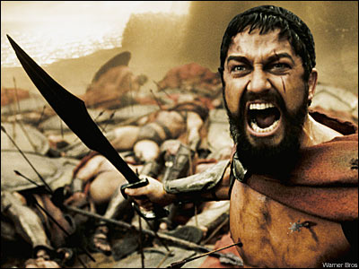
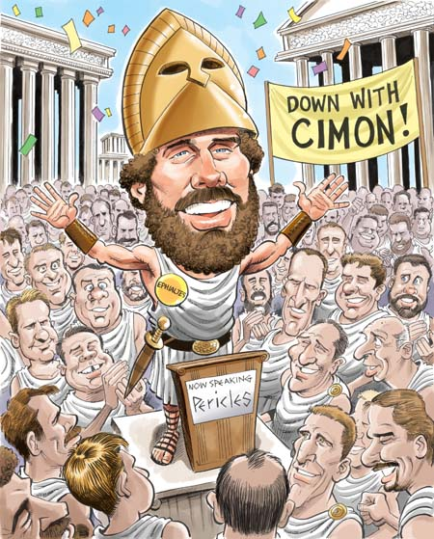
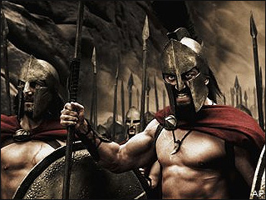
Athens vs. Sparta

Slide 10
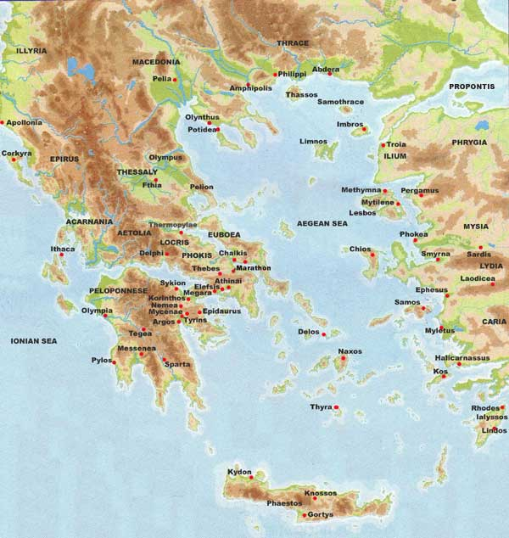
Sparta
All had equal rights
Helots (slaves) did work
Men trained for military
Suppressed individual
Life dedicated to military

Slide 11
Sparta
Family life second priority to polis
Women were very free (healthy woman—healthy child)
Good wives; strict mothers
Owned property, ran estates

Slide 12
Athens
Issues
Aristocrats seized land of poorer
Debt slavery
Draco (621) – Code of laws
Aristocrats still in charge
Oppressive rule

Slide 13
Athens
Solon – Extraordinary power
Freed people enslaved over debt (made it illegal)
Poor allowed into assembly
546 Tyrant
Took power from aristocracy
Building projects
Growth of democratic ideas

Slide 14
Athens
Cleisthenes (508 BCE)
Deme – local unit of jurisdiction
All full citizens sovereign
Offices created and power delegated
Judicial, legislative, executive
Women had no rights

