Slide 1
Islam

Slide 2
Islam
Muhammad
From Mecca
Kaaba
Prophet
Angel Gabriel
Muhammad called to be the messenger of God (Allah)
Few followers in Mecca
Merchants feared his teaching would disrupt trade
Muhammad fled to Medina (hijra) 622

Slide 3
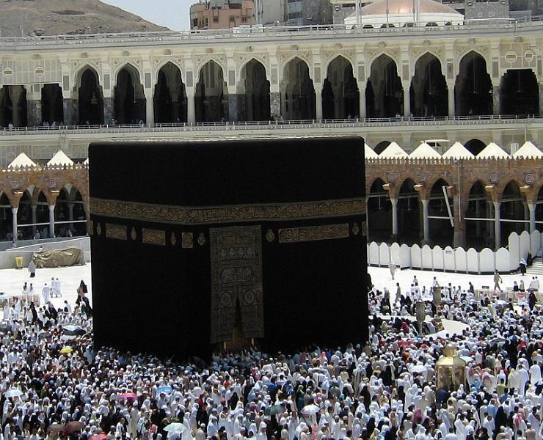
Islam spread in Medina
Muhammad defeated Meccans
Destroyed idols in Kaaba and rededicated to Allah
Muhammad continued to unite Arabs under Islam
Died 632

Slide 4
Nuts and Bolts
Holy Book: Quran
Language: Arabic
Holiest City: Mecca
Why? Kaaba
Place of worship: Mosque

Slide 5
Islam = submission
Muslim = one who has submitted

Slide 6
Nuts and Bolts
Duties
Five Pillars
1.) Declaration of Faith
2.) Pray five times daily
3.) Charity (almsgiving)
4.) Ramadan
5.) Hajj (pilgrimage to Mecca)
Jihad
Struggle in God’s service (end immorality
Interpreted as a holy war

Slide 7
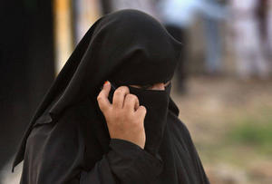
Gender Roles
Limited Rights
Needed a guardian
Spiritually equal, but not legally equal
Modest dress
Took veiling idea from Persians

Slide 8
Split
Muhammad died 632
No son or successor
Had a daughter (Fatamid) and son in law (Ali)
Shi’ites
Believed the next leader has to be related to Muhammad
Relation to Muhammad makes him divine

Slide 9
Split
Sunnis
Muhammad’s successor should be a pious male from Muhammad’s tribe
Not a prophet or divine

Slide 10
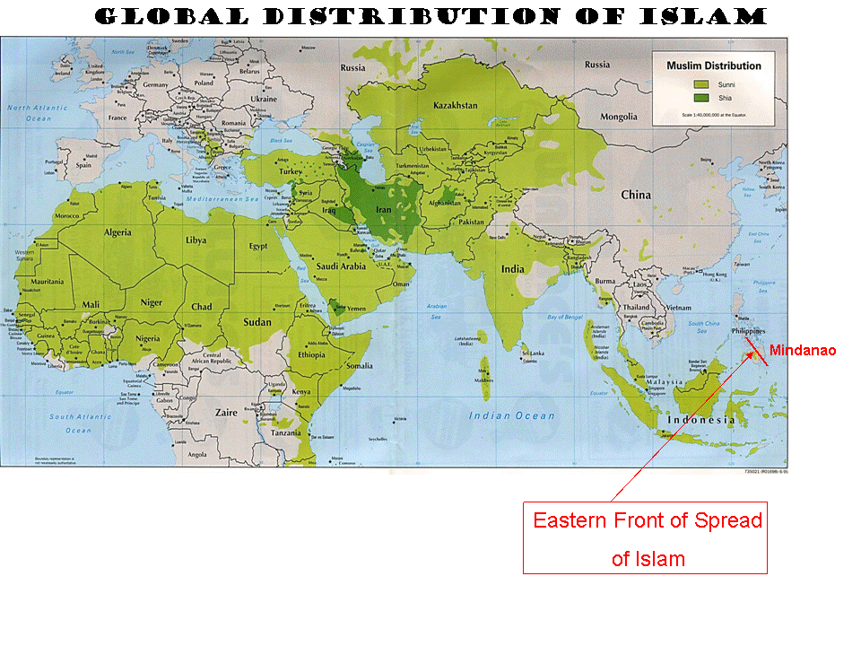

Slide 11
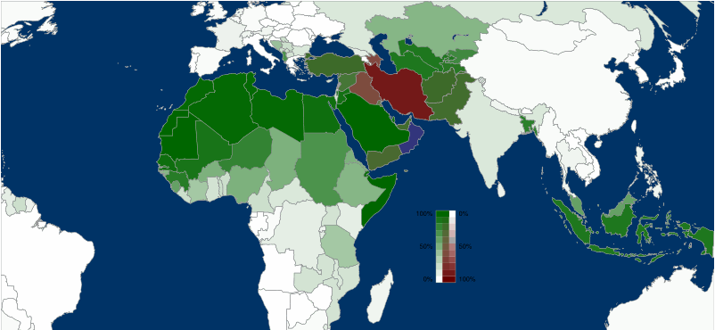

Slide 12
Dar al-Islam = House of Islam
Lands under Islamic rule

Slide 13
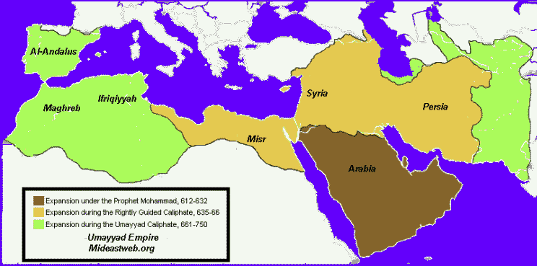
Formation of Empire
Abu Bakr (first Caliph) Muhammad’s father in law
Three successors
Rushidan or Rightly-Guided Caliphate

Slide 14
Umayyad Caliphate
Family from Mecca
661-750
Expansion

Slide 15
Abbasid Caliphate
Umayyads fled to Spain (Al-Andalus Caliphate)
750 – 1058 (remained a leader of Islam—by title—until 1258)
Seljuk Turks (1058)
Mongols (1258)

Slide 16
Abbasid Dynasty
Abu al-Abbas
Stopped expansion (but Islam grew)
Capital moved to Baghdad
High point (Harun al-Rashid)
R. 786 – 809
Supported arts
Gave money to poor and commoners
Sons fought civil war
Continual succession problems
Regional leaders started acting indpendently

Slide 17
Economy and Society
New crops
Managed well in hot weather
More food
Cotton

Slide 18
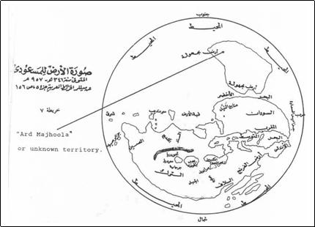
Advancement
Paper making
Massive trade
Overland
Camel
Inherited roads
Indian Ocean Trade
Banks
Credit
Check

Slide 19
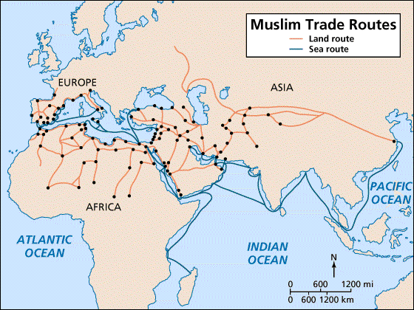

Slide 20
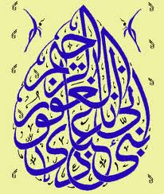
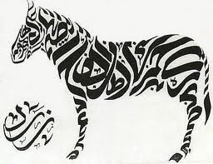
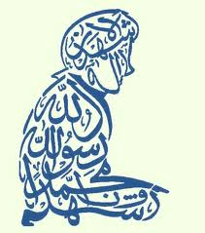
Advancement
Calligraphy

Slide 21
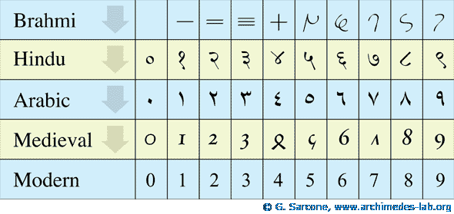
Advancement
Astronomy
Know where Mecca is
Philosophy, medicine, mathematics
Preserved Greek Philosophy
Wrote medical encyclopedia (Ibn Sina)
Arabic numerals (and zero)
Algebra!

