Slide 1
Judicial Branch

Slide 2
Supreme Court
Constitutional Courts (Judicial Power)
District Court, Court of Appeals
Special Courts (Created by Congress)
Tax courts, territorial courts, appeals for armed forces

Slide 3
Jurisdiction – authority of a court to hear a case
Federal Jurisdiction – issues of federal law and interpretation of the Constitution
Concurrent jurisdiction – mix of state and federal jurisdiction
Plaintiff – person filing the suit
Defendant – person against whom the complaint is made

Slide 4
One can appeal a ruling to make sure a lower court acted in accord with law
Appellate jurisdiction
Can modify a decision

Slide 5
Federal judges
Nominated by pres, confirmed by Senate
Term: life (would make an independent judiciary

Slide 6
Judicial Philosophy:
Judicial restraint: Judges decide cases on
1. the original intent of the framers or those who enacted the statutes
2. precedent -- a former decision that serves as a guide for later cases
What has the court done in the past?
Let the majority determine public policy
Judicial activism
Interpret and apply Constitution/statutes in light of conditions and values

Slide 7
Supreme Court
Judicial Review – Court could declare acts of Congress unconstitutional
Marbury v. Madison
If appeals get to Supreme Court:
1. Supreme Court allows lower court ruling to stand
2. Supreme Court remands case – sends it back to lower court for reconsideration
3. Supreme Court decides the case

Slide 8
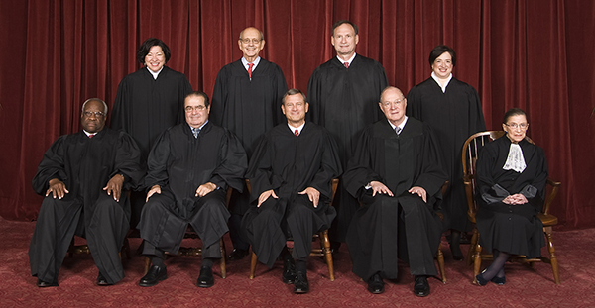
Supreme Court gets cases through appeal or certificate (if a lower court does not know how to rule)
How the court operated:
1.) Oral Arguments
2.) Briefs (filed written statements from both sides) are read as well
3.) Court Conferences (discussion led by Chief Justice)
4.) Court Issues Opinion (vote—best of nine wins)
5.) Majority and dissenting opinions issued

Slide 9
Rights of the Accused
Habeas Corpus – Prisoner must be brought before the court and the officer must show cause why the prisoner should not be released

Slide 10
Steps of Justice
1. Arrested
There must be a warrant or officer must act on probable cause
No unreasonable search and seizure
Can request writ of Habeas Corpus
2. Interrogation
Accused has right to counsel and to remain silent (Miranda Rights)
No coerced confession
3. Grand Jury Proceeding
Decides if case should go to trial by reviewing evidence

Slide 11
Steps of Justice
4. Trial
Must be w/in 100 days of arrest
Accused may request change of venue
Guaranteed counsel (Gideon v. Wainwright) and no self-incrimination
Witnesses called/subpoenaed
Jury’s conviction must be unanimous
No double jeopardy – once a person has been tried, they cannot be retried for the same crime
Right to trial by jury can be waived –bench trial or plea of guilty
5. Punishment
Fines can’t be excessive
No cruel and unusual punishment
6. Appeals
Either side can appeal a verdict

