Slide 1
Rise of Russia

Slide 2
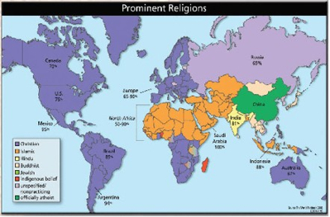
Where are we in the world?

Slide 3
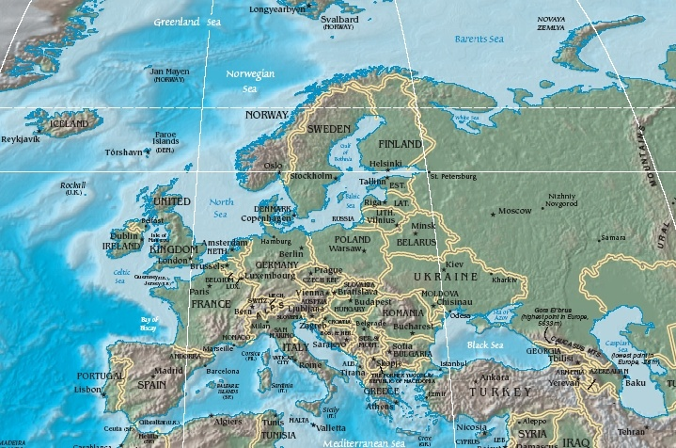

Slide 4
Geography
Northern forests – A lot of lumber and fur. Poor soil
Steppe – A grassland along the southern region of Russia. Great for nomadic people. No barriers.
Modern day Ukraine – Excellent Farming land.
Rivers linked them to south.
Trade
Transportation

Slide 5
Why is Russia called Russia
Named from a tribe called the Rus
Scandinavian (Viking)
Settled in Russia
Moved south and joined Slavs (people north of the Black Sea
Eventually, the line between them vanished, through intermarrying
Russian culture is a mix of Slavic, Greek, and Scandinavian influences

Slide 6
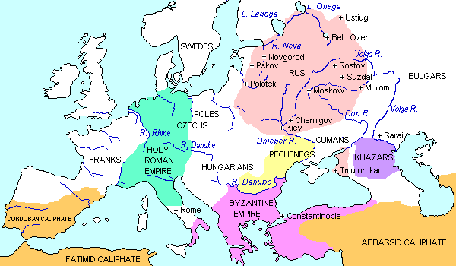
Russia (Pre Mongol)
Blend of Scandinavians and Slavs
City: Kiev

Slide 7
Religion
987
Vladimir needs to choose a religion
Sends emissaries to study
1.) Eastern Orthodox
2.) Islam
3.) Roman Catholicism
What are the advantages and disadvantages?
(Think about the fact that you are studying this for a king)

Slide 8
Eastern Orthodox
Cyrillic Alphabet

