Slide 1
Korea and Southeast Asia

Slide 2
Chinese Influence
Korea and Vietnam
Invasions during Qin and Han
Again during Tang
Tributary System

Slide 3
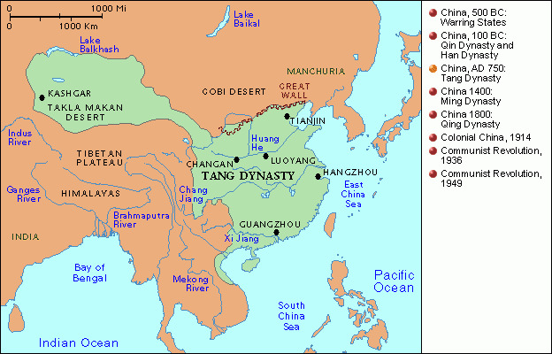

Slide 4
Korea (Silla Dynasty) 669-935
Tang invaded
Silla recognized Tang as overlords
Tributary system
Cultural diffusion
Bureaucracy, capital
Confucianism, Buddhism

Slide 5
Vietnam
China invaded and tried to absorb area into their society
Tributary relationship
Chinese irrigation and agricultural methods
Viet elites studied Confucianism
Viet resented Chinese attempts at domination
Revolts
Retained indigenous religions
Women had (a lot) more rights and freedoms

Slide 6
Indian Influence
Southeast Asia (Thailand)
Hinduism and Buddhism introduced very early
Literature: Ramayana and Mahabharata (promoted Hindu values)
Buddhist works
Funan kings adopted term raja for themselves
Participation in Indian Ocean trade

Slide 7
Khmer Empire/Angkor Empire (889-1431
Deeply Buddhist
Built capital at Angkor Thom
Angkor Wat →

Slide 8
