Slide 1
Crisis

Slide 2
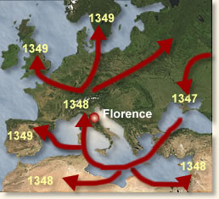
Black Death
1347-1352
Bubonic Plague
Spread to Europe through trade from China
Rats on ships
Fleas carried disease

Slide 3
Plague in Europe
Exacerbated (made worse) by filthy conditions of European cities
Crowded cities (sewage in streets)
No personal hygiene
People had lice and fleas

Slide 4
Response to Black Death
Flee the cities
Persecute Jews
Eat, drink, and be merry
Self-punishment of sins
No rational response

Slide 5
Church Crisis
Western Schism
Confusion over papacy
French king moved pope to Avignon
Cardinals rebelled
Three popes at once
Church unavailable during crises

Slide 6
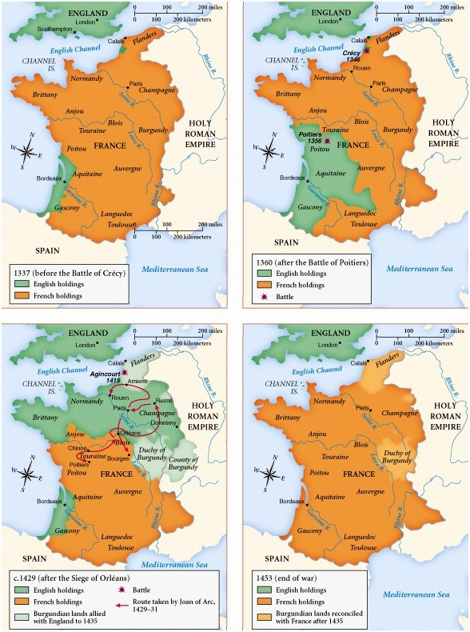
Hundred Years War
1337-1453
English king tried to claim French throne
English very successful at first
Longbow

Slide 7
French fought back
Joan of Arc (1429)
Convinced king to let her lead French Army
She led the French to victory at Orleans
Raised French Morale
Murdered and became a martyr
Canonized 1920
The French also utilized cannon

Slide 8
French win
Push English out

Slide 9
Effect of Hundred Years War
End of Middle Ages
Longbow made knights obsolete
Cannon made castles obsolete
Power of church declined
Church leaders were not available during major crises
Parliament gained power in England
(Power of the purse)

Slide 10
Effects and Outcomes
1.) Crusades
Luxury Goods
Philosophy
Medicine
2.) Black Death
Labor shortages
Increased monarchical power
Loss of trust in Church
More Schools openned
Increased Women’s rights
3.) Western Schism
Loss of trust in Church
4.) Hundred Years War
End of Middle Ages
More Powerful Parliament

Slide 11
End of Middle Ages
Towns larger
Guilds

Slide 12
Migrations 600-1450
Arabs
Vikings
Turks
Mongols
Bantu

