Slide 1
Renaissance, Reformation, Scientific Revolution

Slide 2
Renaissance
What? Rebirth of Classical Learning and Culture
Where? Northern Italy
Why? Patronage
Who?
Leonardo da Vinci
Michelangelo
Raphael
Individualism
Renaissance Man

Slide 3
Machiavelli
North
Shakespeare
Johan Gutenberg
Printing Press
Vernacular

Slide 4
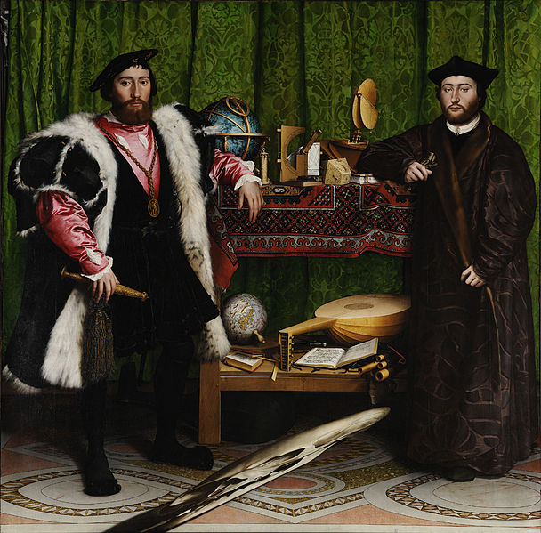

Slide 5
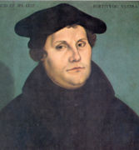
Reformation
Martin Luther
95 Theses
Complaints:
Indulgence
People should read the Bible themselves
Declared a heretic
Diet of Worms
Edict of Worms

Slide 6
English Reformation
Henry VIII wanted an annulment
Made himself head of church
Church of England/Anglican Church

Slide 7
The Reformation
John Calvin
Calvinism
Predestination
John Knox
Presbyterianism

Slide 8
Religious Conflict
Germany (Protestant/Catholic fight)
Peace of Augsburg 1555
Princes choose religion
30 Years War 1618-1648
Peace of Westphalia
Spanish Reconquista
Inquisition (1498)

Slide 9
Catholic Reformation
Jesuits
St. Ignatius of Loyola
Education and stop spread of Protestantism
Council of Trent
The Church’s interpretation of the Bible was final.
Christians need faith and good works for salvation.
The Church’s power was equal to that of the Bible.
Indulgences were a valid expression of faith.

Slide 10
Legacy of the Reformation
Changes encouraged by the reformation:
The Church no longer united Europe.
Monarchs of Europe became more powerful.
Groundwork laid for the rejection of the ideas of Christianity by western civilizations in the future.
Set the stage for modern western civilization.

Slide 11
Jews in Europe
Temple
Visigoth Spain
Anti-Judaism and Anti-Semitism
Stereotypes
Spanish Inquisition

Slide 12
Scientific Revolution
Question accepted beliefs
Use observation and data to draw conclusion
Scientific Method

Slide 13
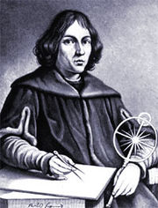
Scientific Revolution
Geocentric Theory
Ancient Greeks and Church
Heliocentric Theory
Nicolas Copernicus
On the Revolutions of the Celestial Spheres
Galileo Galilee
The Starry Messenger
Isaac Newton

