Slide 1
Ottoman Empire
Rise

Slide 2
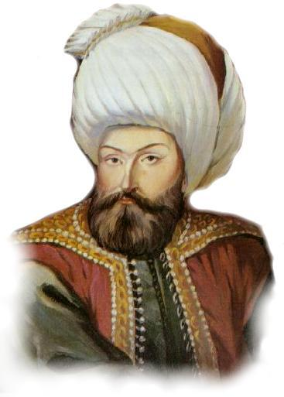
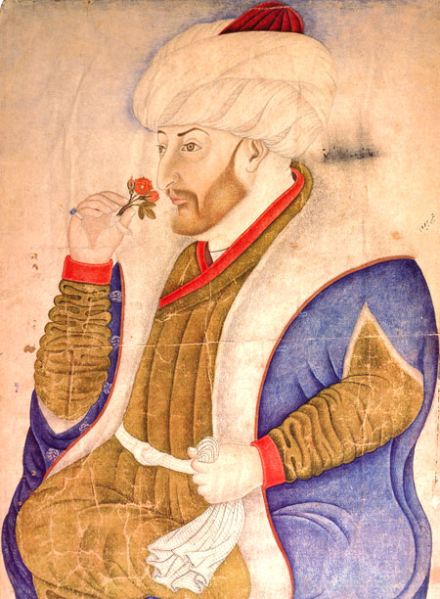
Semi-nomadic Turks
Named for Osman (1280-1324)
Expanded
Slowed by Tamerlane (1402-1405)
Took Constantinople in 1453
Under Mehmet II

Slide 3
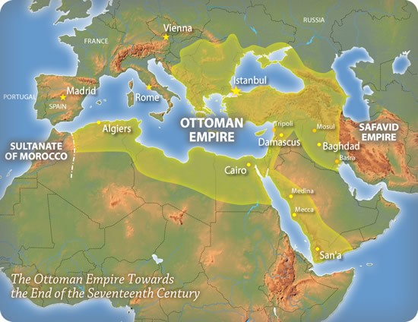

Slide 4
Strengths
Settled Nomads – Mobile
Gunpowder
Location
Trade
Determination
Political Alliances
Women Rights
Strong sultans at the beginning

