Slide 1
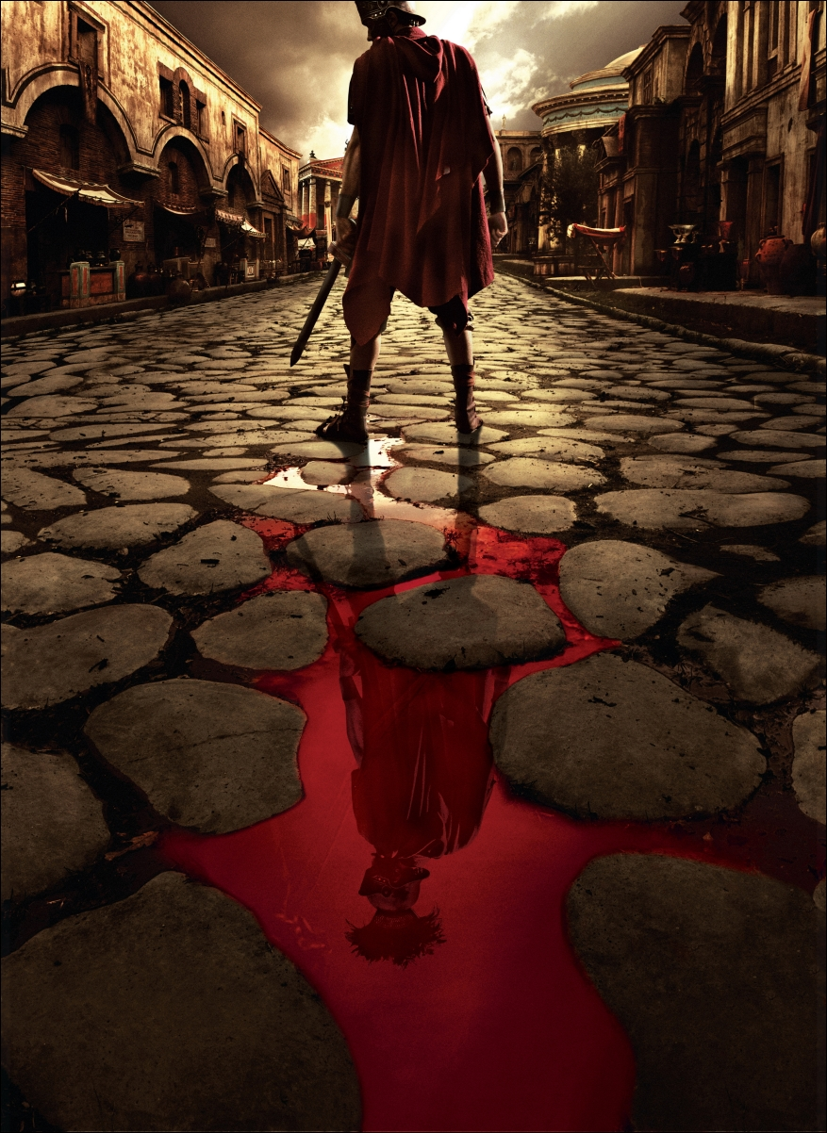
Rome

Slide 2
Politics
TIMELINE
753 BCE –founding of Rome
509 BCE – Roman Republic founded
~100 BCE – Civil War begins
46-44 BCE – reign of Julius Caesar, beginning of Imperial control
31 BCE – 14 CE – reign of Augustus
476 CE – Collapse of the Western Roman Empire

Slide 3
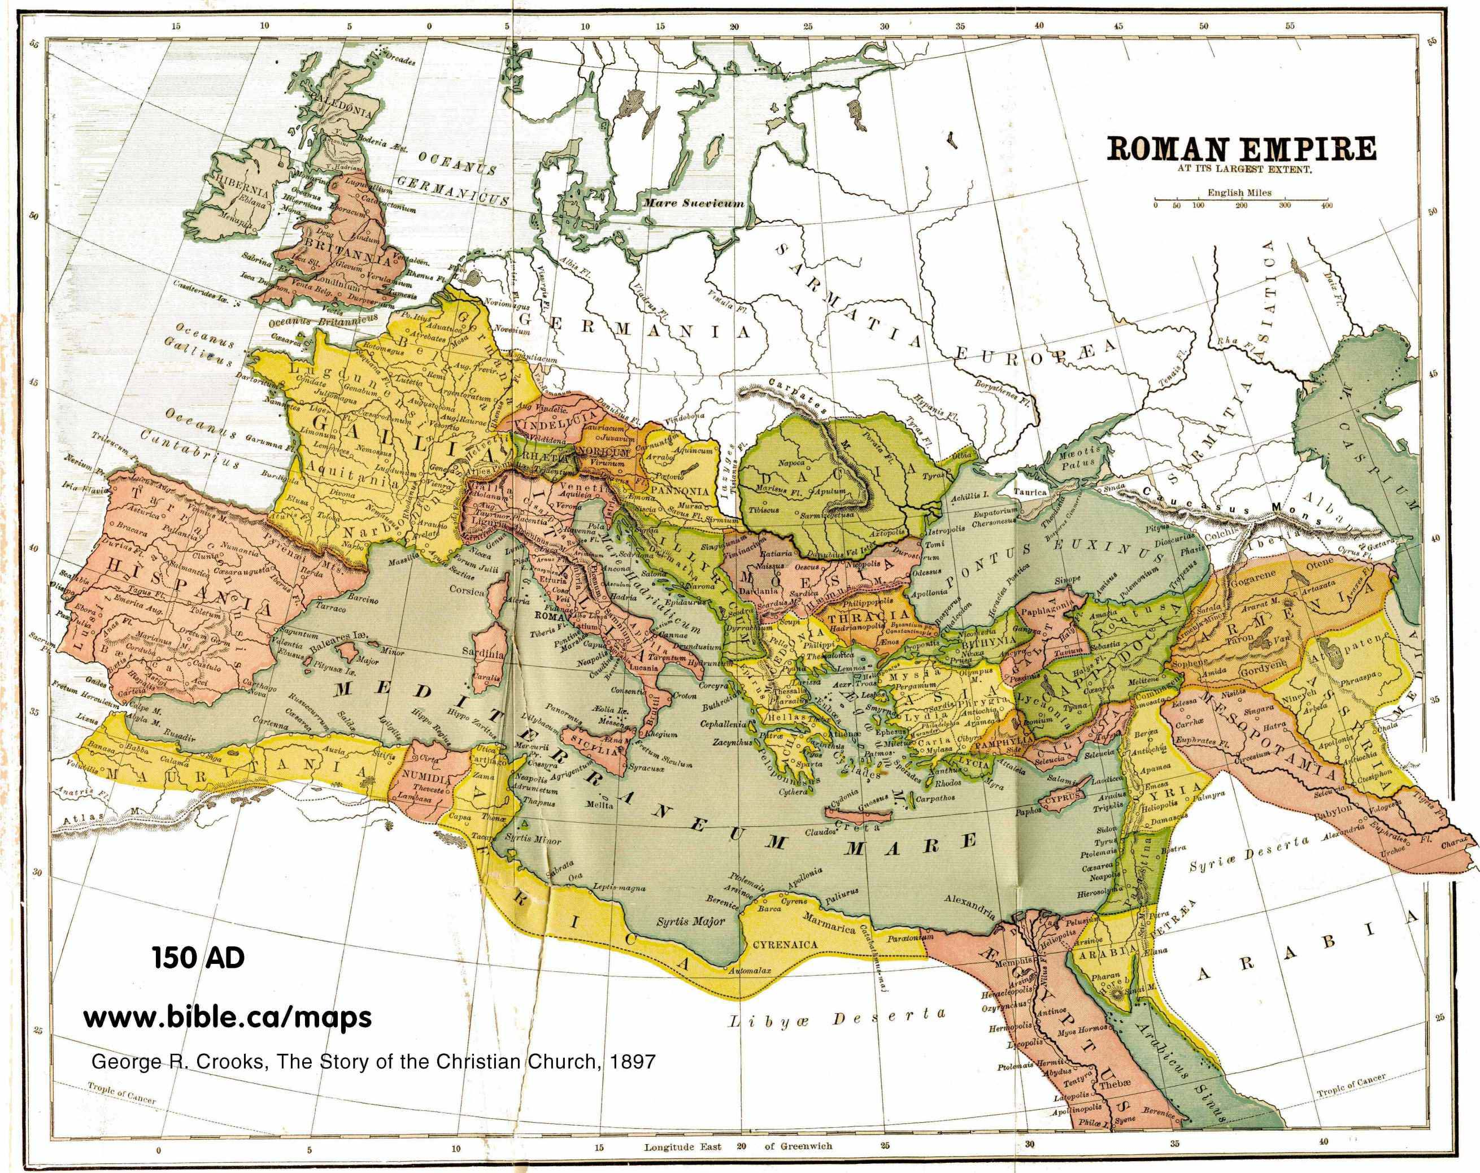

Slide 4
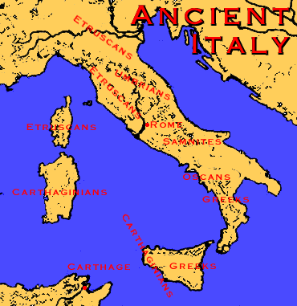
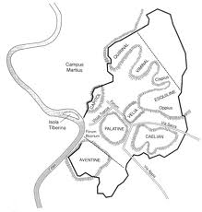
Early Rome
Founded 753 BCE
Tibur River/7 hills

Slide 5
Etruscan Rule
Forum – public area
Rome goes from a collection of villages to a city

Slide 6
Republic
Founded 509 BCE
(Etruscans driven out across next century)
390 BCE
Celts sack Rome
Rebuild
Conquer rest of Italy
Military
Roads

Slide 7
Roman Government
“The Roman Senate and the people”

Slide 8
The Government
Chief magistrates
Two Consuls
Magistrates
Censors
Quaestors
Praetors

Slide 9
The Government
Senate
Advised consuls
Sat every year (stability)
Could not pass legislation – only advice
Eventually advice came to have force of law

Slide 10
Social Division
Aristocracy in charge
Patricians – (Wealthy landowners)
Dominated affairs
Monopolized knowledge of legal procedure
Common People
Plebeians
Free citizens, voice in politics
No high office
Most were poor (except merchants)

Slide 11
Social Conflict
“Struggle of the two orders”
Plebeians want:
Political representation
Safegaurds against patrician domination

Slide 12
Social Conflict
Often plebeians boycott and patricians compromise
Could intermarry
Plebeians granted Tribunes who bring grievances to senate
Patricians codified the law (12 Tables)
Legal procedure made public

Slide 13
Social Conflict
Eventually, rich plebeians could hold magistrate positions
Then sit in Senate (287)
Then got right to hold one of two consuls
All citizens granted equality
New Nobility:
Wealthy plebeians + patricians

Slide 14
Roman Expansion
Monarchy →
Republic→
Civil War →
Imperial System
Punic Wars
Rome vs. Carthage
Control of the Mediterranean
1st Punic War 264 – 241 BCE
2nd Punic War 218 – 201 BCE
3rd Punic War 146 BCE

Slide 15
Roman Expansion
Conquered Greece, Macedon, Saleucids
Pergamum willed to Rome
Ptolemies give in to Roman rule
Mediterranean = mare nostrum

Slide 16
The Roman Empire to 146 BCE
The empire was based in Italy.
The genius behind Roman expansion is that conquered peoples could become citizens

Slide 17
The Roman Empire, c. 117 CE
Rome expands rapidly when it becomes an “Imperial Government”

Slide 18
Roman Society
Paterfamilias – oldest dominant male of the family
Slavery by conquest, not race
Manumission possible

Slide 19
Roman Society
Rome now a great city with Greek culture
Bathhouses

Slide 20
Roman Society
Problems with expansion
Veterans often forced to sell land and move to city
Rich buy up small farms
Latifundia –
large plantations
Owned by Patricians
Put small farms out of business
Food for export

Slide 21
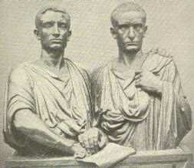
Reform
Tiberius Gracchus 133 BCE
Divide public lands among poor
Result: Murdered
Gaius Gracchus
Give grain to urban poor
Other basic reform
Result: Murdered

Slide 22
Reform
Gaius Marius
Promises land to soldiers, Senate renegs
Soldiers loyal to commanders now, not senate
Sulla
Makes himself dictator
Stepped down after 9 years

Slide 23
Reform
Senate failed to meet needs of an empire
Senate failed to control army

Slide 24
59 BCE 1stTriumvirate formed
Julius Caesar, Pompey, Crassus
Caesar asked to give up command
Crossed Rubicon
Defeated Pompey

Slide 25
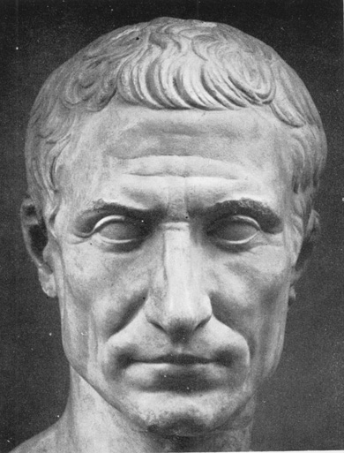
Caesar
Became dictator 47 BCE (44 BCE named dictator for life)
Reform
Assassinated 44 BCE

Slide 26
2nd Triumvirate
Octavian, Marc Antony, Lepidus
Defeated Caesar’s murderers
Split ruling empire
Turned on each other
Octavian (with power of Rome) waged war with Antony (allied with Cleopatra of Egypt)
Octavian wins at battle of Actium

Slide 27
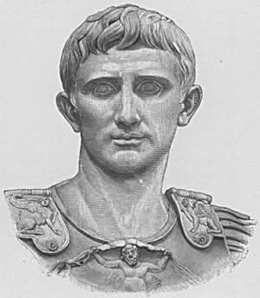
Octavian
Given new name : Augustus (exalted one)

Slide 28
Augustus
Wounds to heal
Gov’t required rebuilding
Army needed demobilizing
Provinces needed welfare and care
Frontiers required protection

Slide 29
Augustus
Place in gov’t?
He is “1st Citizen of the State”
Held consulship and all tribuneships
He gave Senate tremendous responsibilities
But they had no power
So Augustus got the responsibility

Slide 30
Augustus
In effect, created constitutional monarchy
Created office of emperor

Slide 31
Augustus
Solutions to probs
Army: unsolved
Armies stayed loyal to commander
Provinces
Encouraged self-rule
Continued expansion in north
Augustus created stability and prosperity
Pax Romana (Roman Peace) Golden Age

Slide 32
Pax Romana – the “Roman peace”
Lasts 200 years
A period of relative peace that allowed trade and communication to flourish

Slide 33
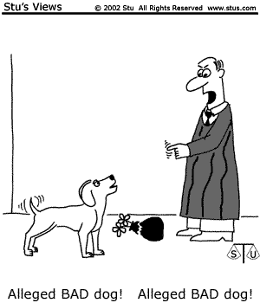
Social
Roman Law
12 Tables - early written laws
Law of Nations – natural laws that could govern any peoples
Trial before a judge and innocent until proven guilty - Roman ideas!

Slide 34
Social
Cities grew (especially Rome)
To feed: emperor provided citizens with free bread, oil, and wine
Entertainment
“Bread and Circus”

Slide 35
Economic
Agriculture boomed (went way of small tenant farming)

Slide 36
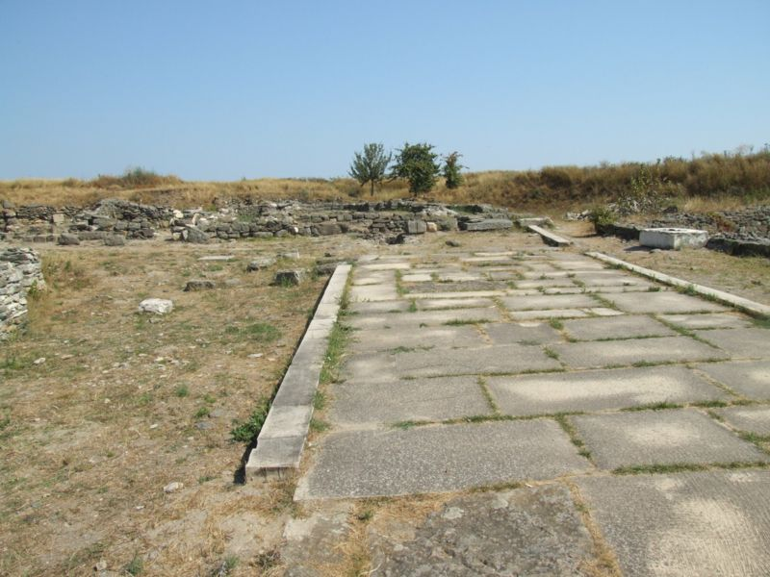
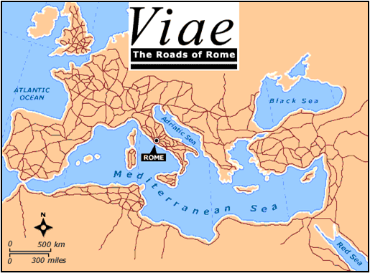
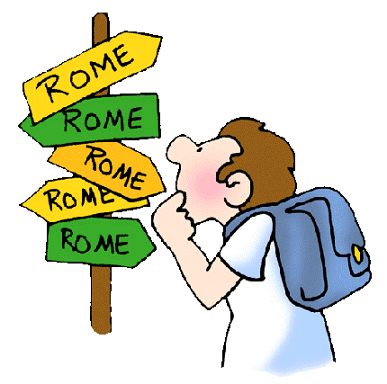
Economic
Roman Roads
“all roads lead to Rome”
Many European cities get their starts under the Romans
London
Paris

Slide 37
Roman Roads
“all roads lead to Rome”
Many European cities get their starts under the Romans
London
Paris

Slide 38
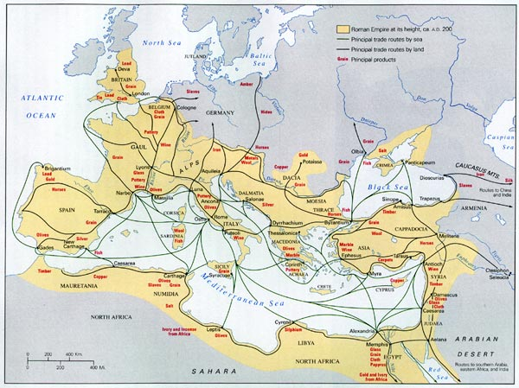
Economic

Slide 39
Economic
Rome expanded east (clashed with Parthians in Iran and later Sasanids)
China expanded west
Parthians acted as middlemen
Silk from China
Glassware, slaves, and gems from Rome

Slide 40
Other contacts
Romans sailed to Indus River
Sailors reached East Indies and traded with Chinese

Slide 41
With roads, and expansion of provinces, Europe is Romanized
Frontiers secured
Army goes from mobile to defensive

Slide 42
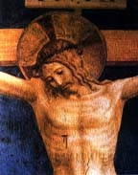
Religious
Early religion – similar to Greek gods
Christianity
Jesus – historical figure
Jesus was imprisoned, condemned and executed by crucifixion, a punishment usually reserved for common criminals. The instrument of his death – the cross – is the most important symbol in the Christian faith.

Slide 43
Religious
Paul – opened the religion to Gentiles (non-Jews)
Spread the word
Initially persecuted in Rome
312 CE – Emperor Constantine –
Edict of Milan “Christianity is okay!”
380 CE – Emperor Theodosius – Christianity becomes the official religion of the Empire

Slide 44
After five good emperors:
200s: civil war and barbarian invasions
Economy shattered, cities shrunk, agriculture became manorial

Slide 45
Problems
Barracks emperors
Invasions (Huns)
Peasants turned to lords for protection
Decentralization
Local economies

Slide 46
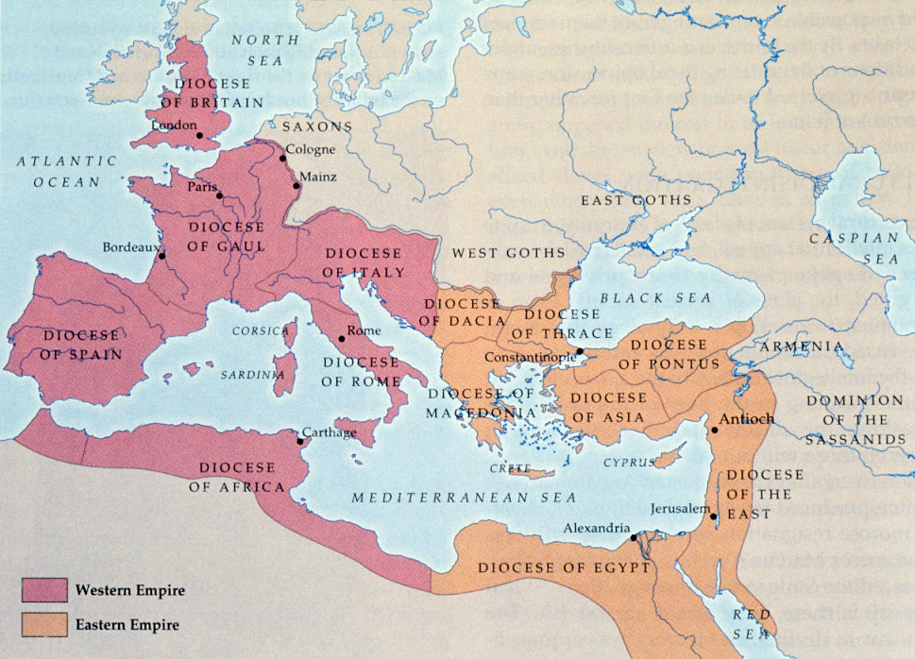
Reconstruction/Reform
Diocletian (r. 284-305)
Elevated emperor
Divided empire

Slide 47
Reconstruction/Reform
Constantine (r. 306 – 337)
Created second capital city (Constantinople)
West was in decline
East still had trade
Tightened up control of army and bureaucracy
Reforms of Diocletian and Constantine were temporary

Slide 48
The Fall of Rome
Germanic invasions
Barracks emperors – military coups
Obsession with silk
Political
– Office seen as burden, not reward.
– Military interference in politics.
– Civil war and unrest.
– Division of empire.
– Moving of capital to Byzantium.
Social
– Decline in interest in public affairs.
– Low confidence in empire.
– Disloyalty, lack of patriotism, corruption.
– Large inequality between rich and poor.
– Decline in population due to disease and food shortage.
Economic – Poor harvests.
– Trade disruption.
– No more war plunder.
– Gold and silver drain.
– Inflation.
– Crushing taxes.
– Gap between rich and poor and increasingly poor West.
Military
– Threat from northern European tribes.
– Low funds for defense.
– Problems recruiting Roman citizens; recruiting of non-Roman mercenaries.
– Decline in patriotism and loyalty among soldiers.

Slide 49
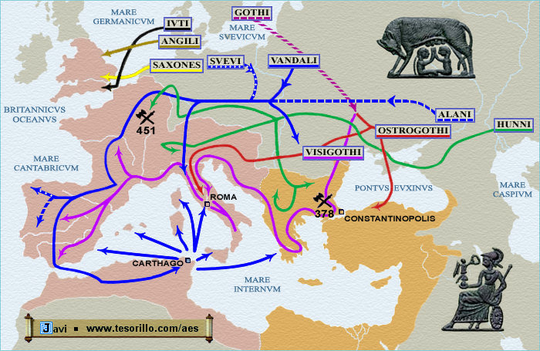
Fall
395 East and West became independent
400s continual barbarian invasion
476 last emperor deposed

Slide 50
In the wake of Rome: 3 major civilizations
East (almost no change) = Byzantine Empire
North Africa = Coptic
Western Europe (most drastic change)
Cut off from Roman legacy
Dark ages

Slide 51
