Slide 1
The Industrial Revolution

Slide 2
What is it?
Massive sweeping change
Production becomes systematic with machines
Massive migration to the cities
Rise of commercial and economic economy
Creation of urban poor

Slide 3
The Chapter
1.) The inventions and foundations
2.) The beginnings
3.) How it changed society
4.) Attempts to fix problems created
Socialism
5.) Drastic change in life
For the better and worse

Slide 4
The old way
Most people worked land
Hand tools
Production by hand

Slide 5
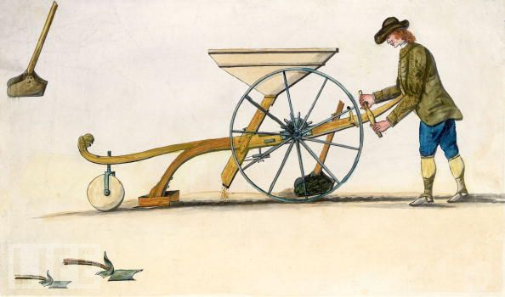
Agriculture Improves
Dutch consolidate land and use fertilizer
Education and spread of ideas
Crop rotation
Jethro Tull’s seed drill

Slide 6
Agriculture Improves
Enclosure – rich landowners taking land formerly shared by peasants
Efficient
Threw farmers off land

Slide 7
Agriculture improvement = more food = higher population

Slide 8
Technology
James Watt – Improves steam engine to be efficient enough for use
Power machinery
Power locomotives

Slide 9
Technology
Iron was improved
Less expensive and stronger

Slide 10
19.2 Revolution in Britain
Why?
Geography
Rivers and ports
Iron and coal deposits
Stable gov’t
Made enclosure easy
Powerful navy
Empire
Capital
Allows enterprise

Slide 11
Starts with Textiles
Old way: Putting out system
Inventions improved
Eventually weavers powered by water
Eli Whitney invented cotton gin
New inventions required larger buildings of production
Factories

Slide 12
Transportation
Goods and resources needed to transport faster and cheaper
Canals
Steam locomotive
Steamships

Slide 13
What do you need to run a successful textile factory?

Slide 14
Urbanization
Movement of people to the cities
Cities exploded
Slums, poverty, harsh living conditions

Slide 15
The chain reaction
Efficient production → Higher quantities → cheaper goods → Goods became more affordable → more people bought them → higher demand → more development of production

Slide 16
How has Industrialization affected your lives?
How did affect people’s lives at the time?

Slide 17
Social Change
Urbanization (move to the cities)
New classes
Middle Class (Bourgeoisie)
Got rich on investing in factories and industry
Took pride in their ability to get rich
No sympathy for poor
Working class (Proletariat)
Underpaid
Lived in terrible conditions in tenements

Slide 18
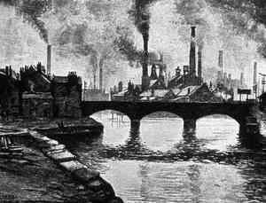

Slide 19
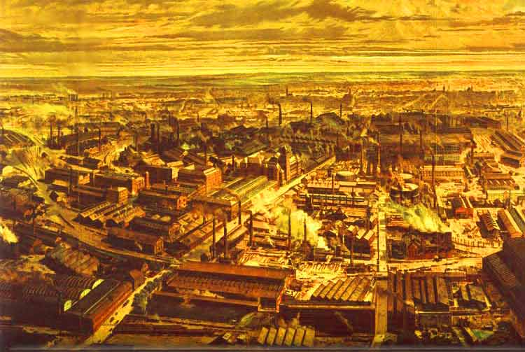

Slide 20
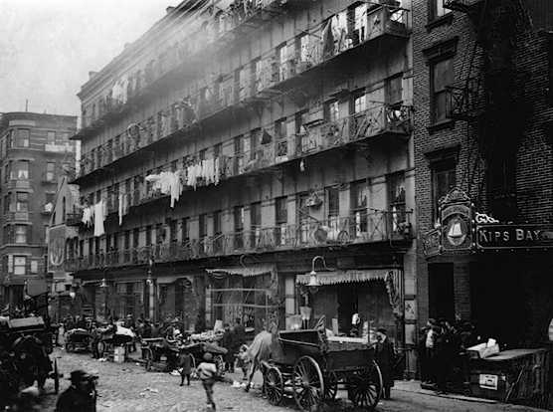

Slide 21
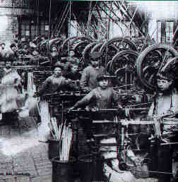
Factory Conditions
Long hours
No safety
If you got sick or hurt, you were fired

Slide 22
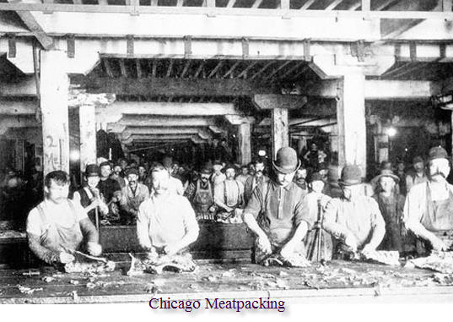

Slide 23
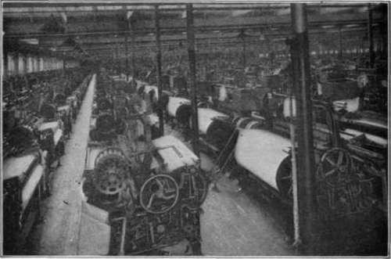

Slide 24
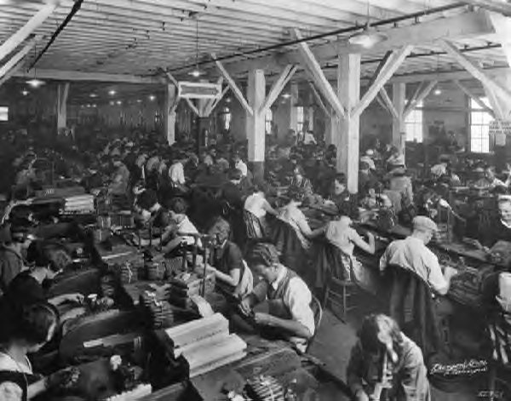

Slide 25
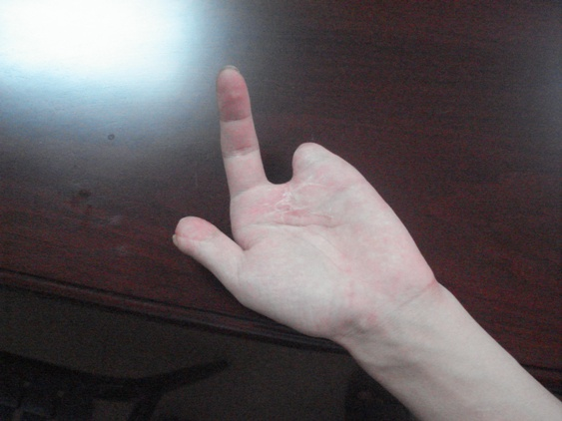

Slide 26
Mining Conditions
Conditions even worse (did get paid more)
Dark, dusty, dangerous
A lot of children
Intense labor

Slide 27
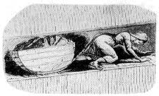
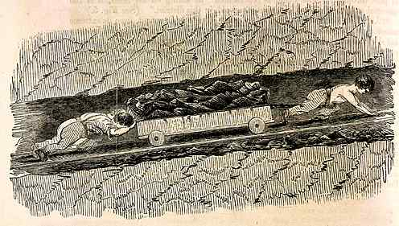

Slide 28
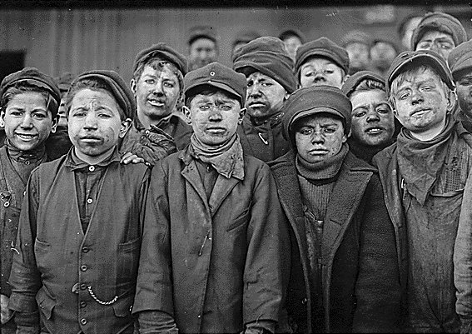

Slide 29
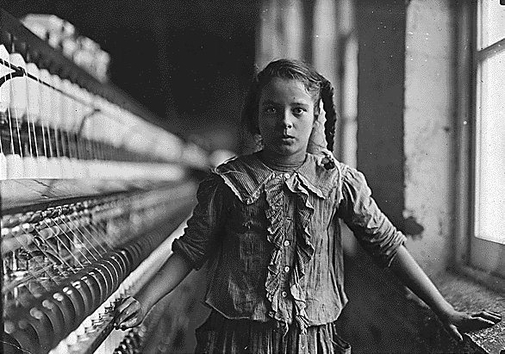
Child Labor
Children were useful and could be paid less
Lost childhood

Slide 30
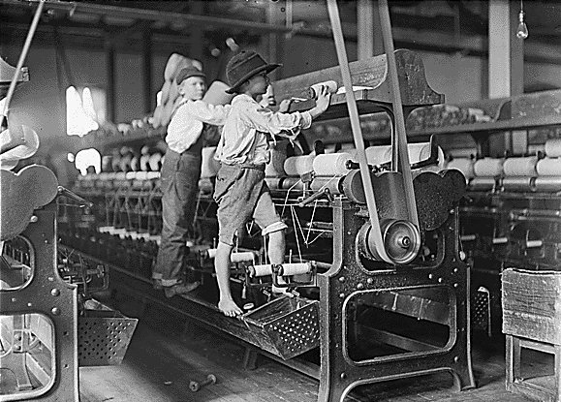

Slide 31
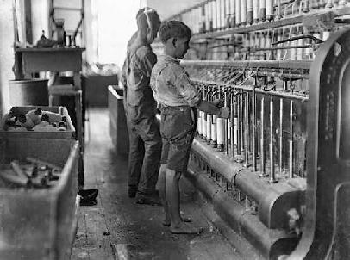

Slide 32
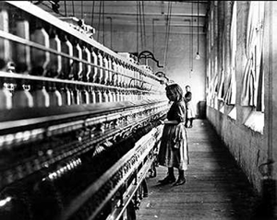

Slide 33
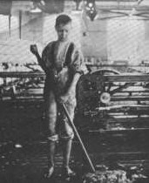

Slide 34
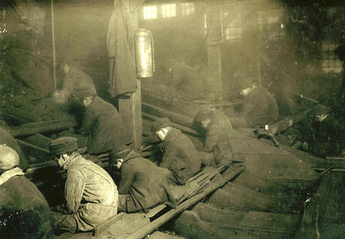

Slide 35
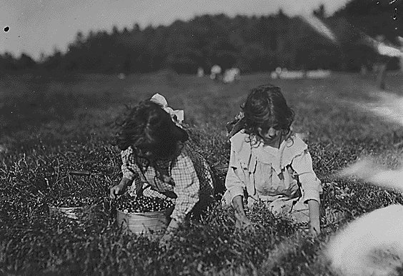

Slide 36
Was the Industrial Revolution a blessing or a curse?

Slide 37
How do you solve the problem of such poverty and social change?

Slide 38
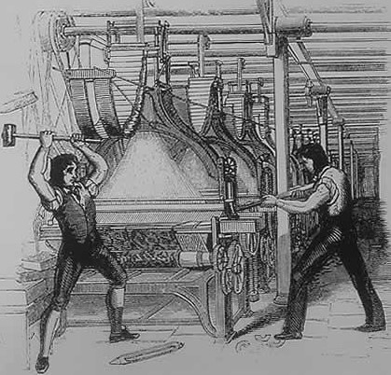
Luddites – English artisans who protested the textile factories
Broke into factories and destroyed machinery

Slide 39
Thinkers
Laissez Faire dictated the market
So it should regulate itself
Thomas Malthus – The population would outgrow food supply
Poor would starve
David Ricardo – “Iron Law of Low Wages”
Don’t raise wages because then the poor workers would only have more children

Slide 40
Solutions
Socialism
The people should own means of production (railroads, factories, mines, etc.)
Utopia (Robert Owen) – a society where work is shared and property is not owned

Slide 41
Utilitarianism
Jeremy Bentham – advocated for Utilitarianism (Goal of society should be the greatest good for the greatest number of people)
All laws should be judged according to their utility
John Stewart Mill
Government should protect workers
Women should vote

Slide 42
You have two cows….
CAPITALISM You have two cows. You sell one and buy a bull.
ANARCHISM You have two cows. The cows decide you have no right to do anything with their milk and leave to form their own society.
DEMOCRACY — REPRESENTATIVE You have two cows. Your neighbors pick someone to tell you who gets the milk.
BUREAUCRACY You have two cows. At first the government regulates what you can feed them and when you can milk them. Then it pays you not to milk them. Then it takes both, shoots one, milks the other and pours the milk down the drain. Then it requires you to fill out forms accounting for the missing cows.

Slide 43
SOCIALISM You have two cows. The government takes one of them and gives it to your neighbor.

Slide 44
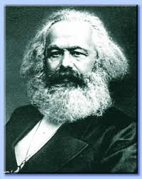
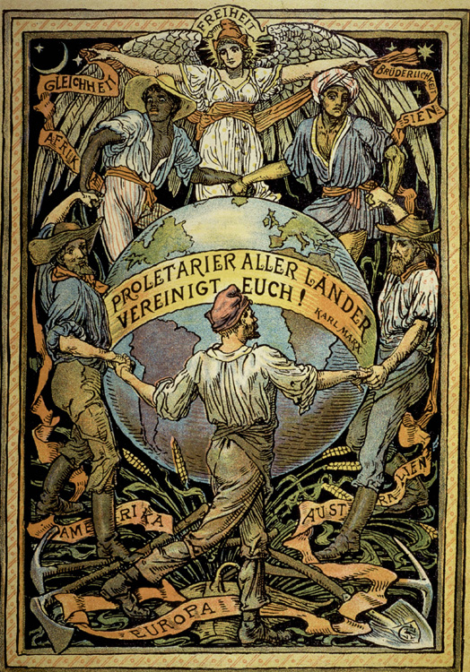
Marxism
Karl Marx
The Communist Manifesto
Establish classless society (Proletariat overthrows bourgeoisie)
In practice communism meant the state controlling everything
#WorkersoftheWorldUnite

Slide 45
COMMUNISM You have two cows. The government takes both of them and gives you part of the milk.

Slide 46
COMMUNISM — “PURE” You have two cows. Your neighbors help you take care of them, and you all share the milk.
Well, maybe the local bully gets more, or a few neighbors band together to kill you so that there is more milk for everyone else.

Slide 47
MARXISM/LENINISM The proletarian cows unite and overthrow the bourgeoisie cowherds. The egalitarian democratic cow revolutionary state with the cow party as vanguard disintegrate over time. Marx choked on a veggie-burger before he could explain what happens to the use-value, exchange-value and sign-value of bovine leather.

Slide 48
Change
Unions
Organization of workers in a common field
Strikes and negotiation
Government Regulation
Relief came very slowly

Slide 49
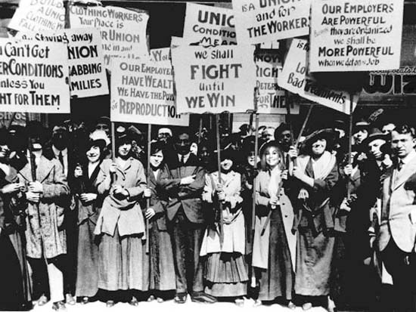

Slide 50
Industrial Revolution and Beyond Across the Next 100 Years:
Technological Explosion
Communication (telegraph, telephone, radio, motion picture)
Steel (skyscrapers, awesome bridges, and stuff)
Transportation (Subways, cars, airplanes)
Warfare (breech loading rifles, rifling, machine guns)
Imperialism (New needs: Rubber, oil for soap)
Medicine (penicillin in 1928)
Other (light bulb, paperclip)
Business
Stocks, corporations
Further regulation

Slide 51
Industrial Revolution and Beyond Across the Next 100 Years:
Art
Photography
Impressionism
Leisure Time (once wages get better)
Beaches
Department Store
Sports
Olympics (1892)
Major League Baseball (St. Louis Cardinals! 1876/1892)
Football (forward pass 1906 by SLU)
Soccer (Arsenal 1886, Barca 1899/Real 1902, Liverpool 1892, Man U 1878)
Movies, Radio, Music

