Slide 1
Trade

Slide 2
Transregional Trading Networks
Silk Road
Indian Ocean Trade
Mediterranean
Trans-Sahara

Slide 3
Why more trade
Imperial support
Technology to make use of pack animals
Saddle, etc
Maritime technology
Lateen sail, dhow ships
Understanding of winds
Monsoons

Slide 4
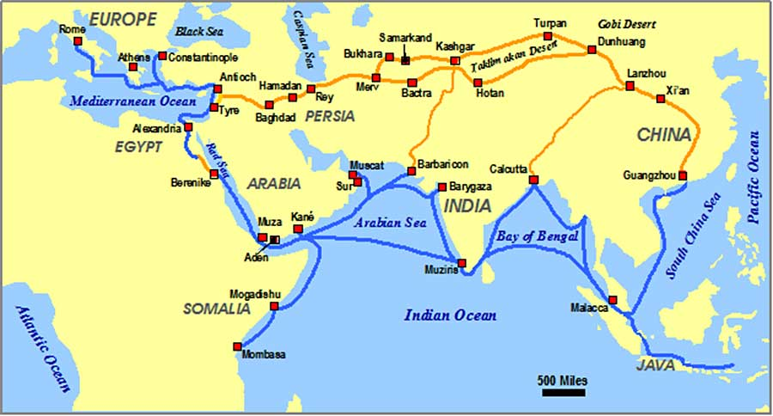

Slide 5
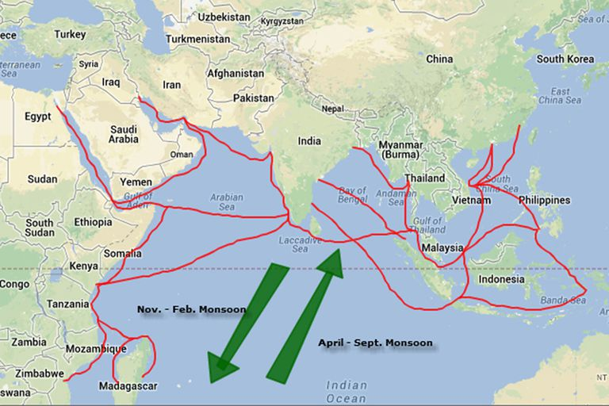

Slide 6
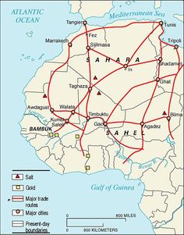

Slide 7
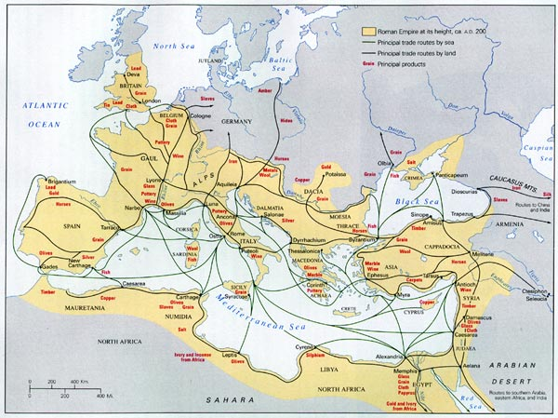

Slide 8
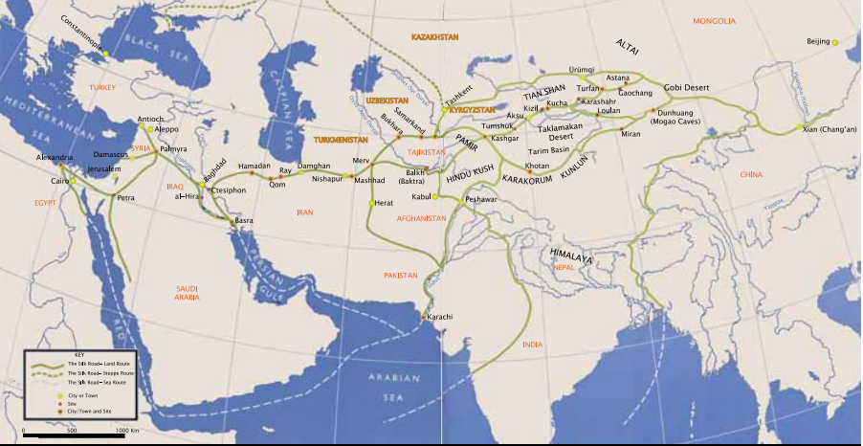

Slide 9
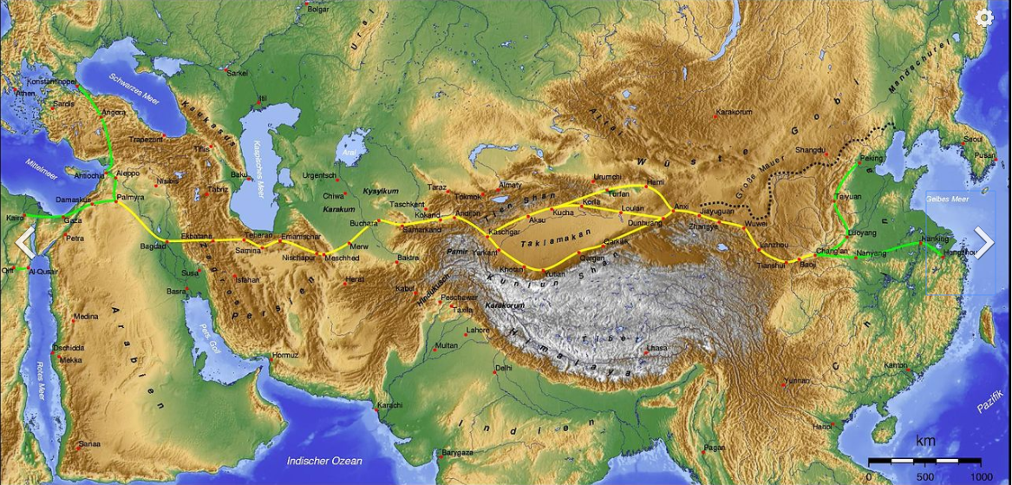

Slide 10
What is exported?
China
Silk, porcelain, iron/bronze
India
Cotton textiles, Spices (saffron, cinnamon, ginger, pepper) ivory
Persia/Middle East
Wool products (rugs), dyes
Central Asia
Horses
Sub-Saharan Africa
Gold, salt, ivory
Europe
Silver, wine, olive oil
Southeast Asia
Spices (cinnamon, pepper, nutmeg)

Slide 11
Crops/agriculture spread
Rice and cotton from South Asia to middle East
Qanat system, water wheels, better wells/pumps (shaduf)
Disease
Religion
Christianity, Buddhism, Hinduism
Religions transformed (syncretism)

